Slide 1
WW1 ART INSTALLATIONS
WORK IN PROGRESS
Presented by
John J. Campbell
Moira Kenny
THE SOUND AGENTS
Artist led - Community driven Arts,
Cultural and Heritage Organisation

Slide 2
An Exploration of the Human Face of WW1
CONCEPT

Slide 3
Meeting Steve Lau Ensuring we remember
While recording The Liverpool Chinese Oral History 2014 funded by HLF The Guardian newspaper published an article about the 96,000 Chinese Labour Corps
The young men had travelled via Liverpool to France and Belgium

Slide 4
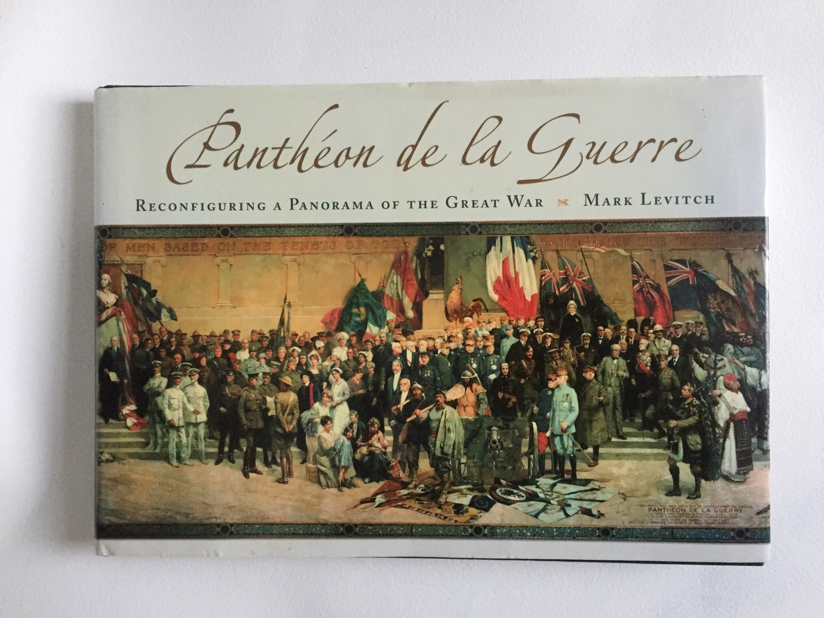

Slide 5
A Cyclorama the size of a football field!
“5,000 full length portraits of prominent figures of WW1.
Artist generated propaganda while the war raged celebrated in Paris as a solemn and nostalgic work after the war, then was promoted as a circuslike spectacle on a post war tour of the United states.
“Updated” to appeal to Americans more celebratory view of the conflict. Consigned to storage and all but forgotten after WWII.
Procured for Kansas City’s Liberty Memorial 1956. Less than 7% of the work reconfigured.
Fragments surfacing on eBay and Paris flea markets”.
MARK LEVITCH 2006

Slide 6
A monumental artwork commissioned by the French government at the beginning of the conflict that saw the Chinese painted out to be replaced by the United States.
“ Painting lent both a dignity to and an oft-needed mental distancing from events and people that photography did not”
P71 MARK LEVITCH 2006
Image:
The Meridian Society CLC Exhibition Liverpool August 2018 Curated by Peng Wenlan, John J. Campbell, Moira Kenny

Slide 7
Three dimensional model showing the composition of The Pantheon de la Guerre panorama. Model: by Casey Servis Fig 4 p 6

Slide 8
Pantheon de la Guerre Building Paris
148 rue de L’Universite Paris Constructed 1916. Photo: Pantheon de la Guerre exhibition catalogue, New York 1920
The dilapidated building shortly before destruction in 1960 (Archives de Paris)

Slide 9
PROJECT DESIGN The Heritage is the untold and unheard heard histories of the Forgotten Heroes of WW1. The time is 1914 – 1918 up to1923.
THE THEMES
Blind men of WW1 working with Blind Veterans UK and drawing upon their archives and historical artefacts. The annual reports for the Outdoor Workshops for 1913, 1916 and 1928 are held in Merseyside Record Office.
The 96 000 Chinese Labour Corps (CLC) who are not recognised for their contribution to WW1 on any of the 100,000 UK war memorials.
The impact the war had on China and how it is relevant to the community in the UK
The untold loss of 5000 Merchant navy ships and 15,000 seafarers

Slide 10
Exploring the hidden stories of social injustice and the effect WW1 had on families and on communities today.
Working in collaboration with:
Mark Levitch Author Pantheon de la Guerre Revisited
Blind Veterans UK
Bill Anderson MNM
National Museums of Liverpool
Museum of London
Liverpool John Moores University
Liverpool Records Office
Outputs:
WW1 Public Art/Heritage Installation
Audio Description
Tour of Blind School buildings and cemeteries
Workshops in the Museum of Liverpool for people to understand the effects of blindness on WW1 soldiers and their families working with blind veterans and their rehabilitation methods.

Slide 11
BACK TO CHINATOWN Home to The Oldest Chinese Community in Europe, Merchant Navy Seafarers Outdoor workshops for Blind

Slide 12
Proposed site for installation
Façade and railings of
The Black-E
founded in 1968
The UK’s first International Community Arts Project
Chinatown, Liverpool

Slide 13
Liverpool School for the Indigent Blind Hardman Street
Founded in 1791 by Edward Rushton and continues to be The Royal School for the Blind today based in Church Road Liverpool
Image:
http://historyof.place/location/liverpool-school-for-the-indigent-blind/

Slide 14
Cornwallis Hall Outdoor Workshops for the Blind
Architect: George Tunstall Redmayne of Manchester 1870.
"The building contained large rooms for making baskets, brushes and matting, and space for lectures and social gatherings. Upper part reconstructed after wartime damage.“ Joseph Sharples 2004.
Image Courtesy of Warren Kern owner of Cornwallis Hall The Outdoor Workshops for the Blind

Slide 15
St Dunstan’s Regents Park Base Blind Veterans UK

Slide 16
Images from the Blind Veterans UK WW1 Archive Courtesy Rob Baker

Slide 17
Ships Lost At Sea Image Culture Nova Dazzle Ship Source: Wales on line

Slide 18
Seldom heard stories made public Black seafarers of the First World War. © Royal Museums Greenwich.

Slide 19
Images of Chinese Labour Corps John de Lucy/Frances Wood Courtesy of The Meridian Society

Slide 20
Bringing the untold stories of everyday people out on to the streets as a public art installation
To commemorate all of the people from all of the countries to share their contribution to WW1 to their communities to pass down to
younger generations now and in the future.

Slide 21
The Sound Agents https://www.thesoundagents.com http://soundagents.blogspot.com
Contact:
John J. Campbell & Moira Kenny
Email: Thesoundagents@gmx.co.uk
Mobile: 07923925379

