Slide 1
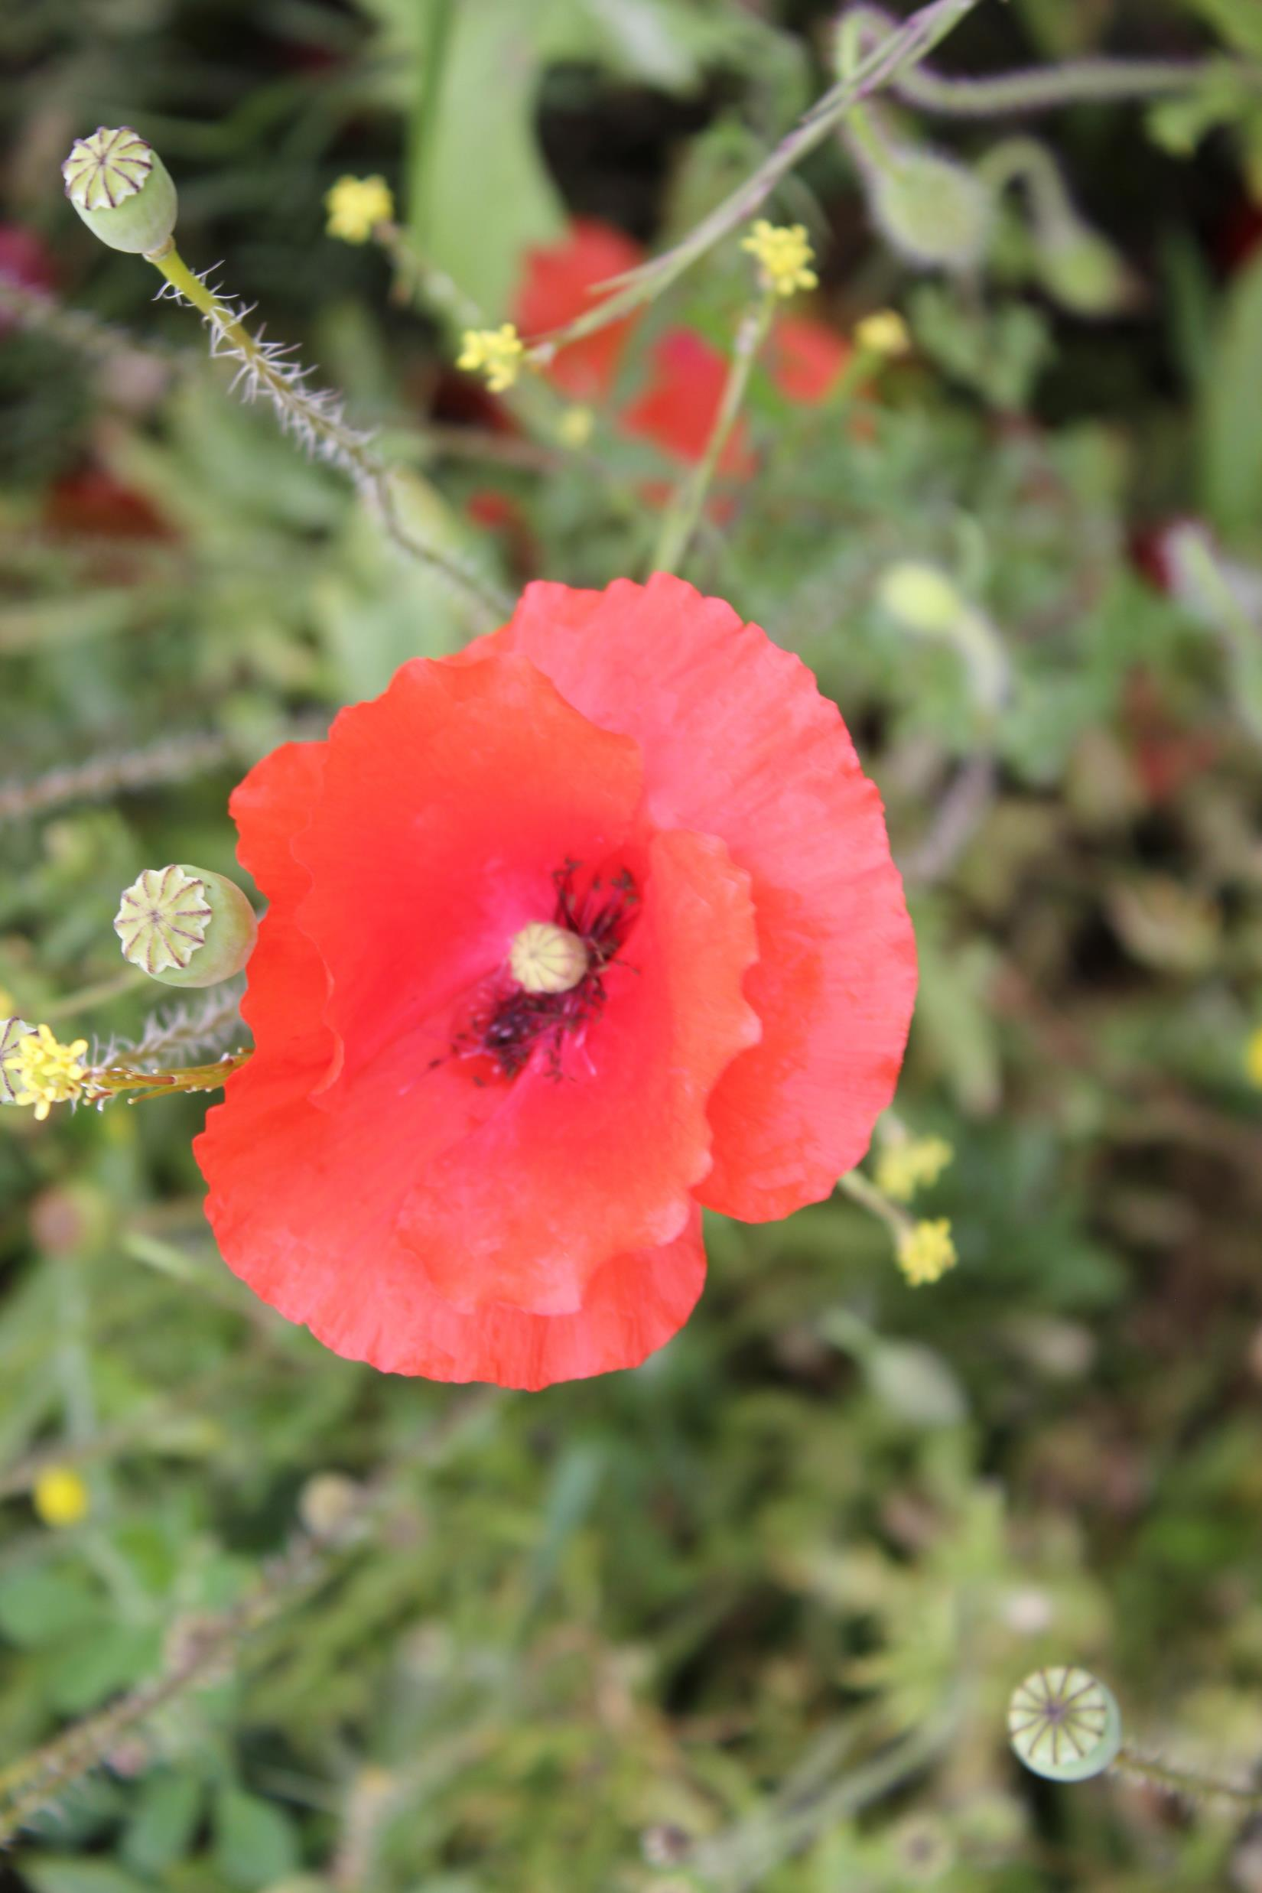
WW1 ART INSTALLATIONS
Presented by
John J. Campbell
Moira Kenny
THE SOUND AGENTS
Artist led
Community Driven
Arts, Cultural and Heritage Organisation

Slide 2
“The Sound Agents exist
to give seldom heard voices
opportunities to share their stories through
engagement with the arts”

Slide 3
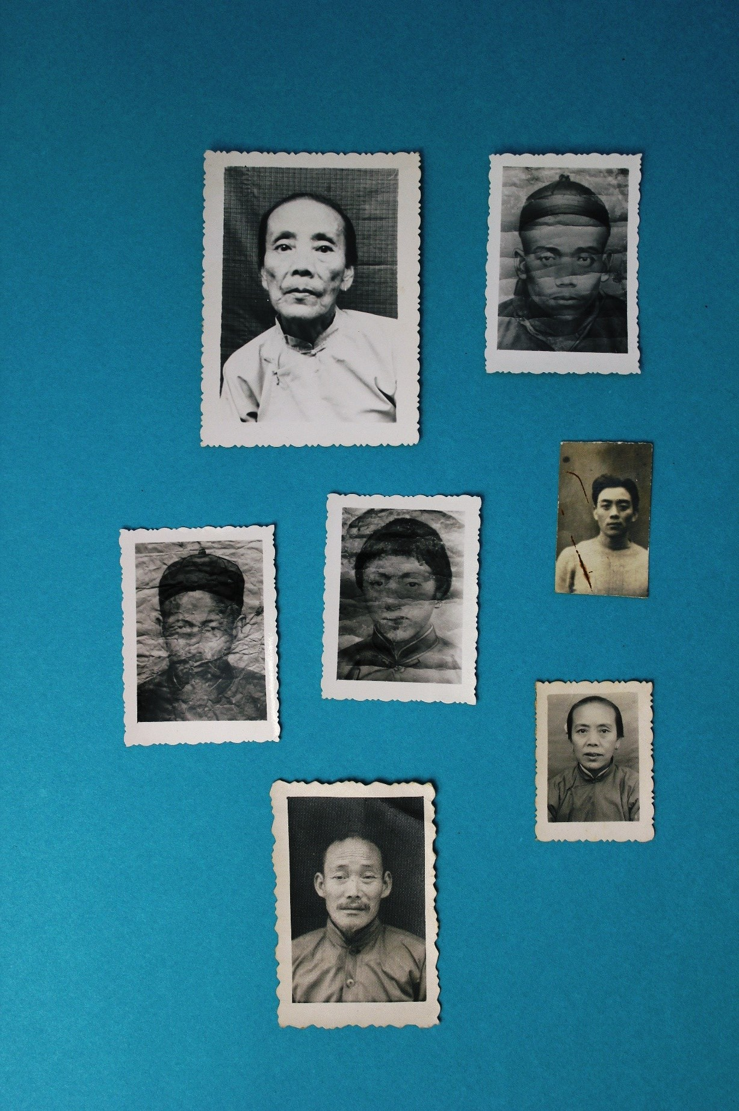
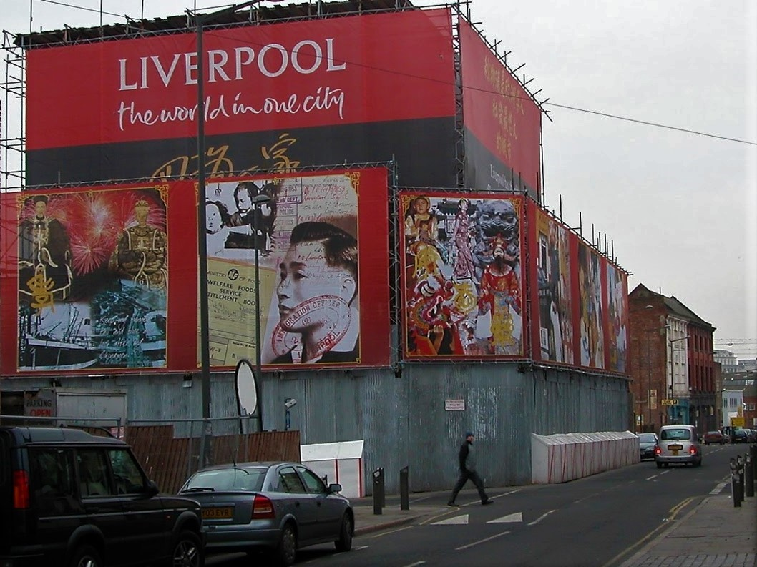
Document a sense of time and place to promote public understanding and access to British hidden Social History
Oral Histories of Seldom Heard Communities
Large format Public Art Installations

Slide 4
Liverpool City Council Commission for The International Business Festival 2014
To beautify the windows and doors of three derelict Georgian buildings in Duke Street Rope Walks Liverpool One
Idea
To create a visual Opera for Chinatown by designing a time line of Blue Funnel Sailors migration, journey and settlement
Pictured: Grace Liu Cantonese Opera Performer and Business woman Liverpool Chinatown

Slide 5
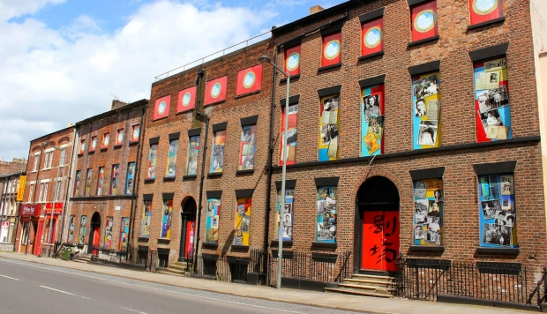
OPERA FOR CHINATOWN
Duke Street

Slide 6
Preserving Heritage for Future Generations

Slide 7
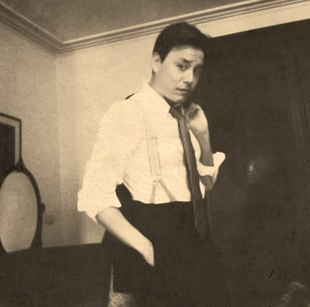
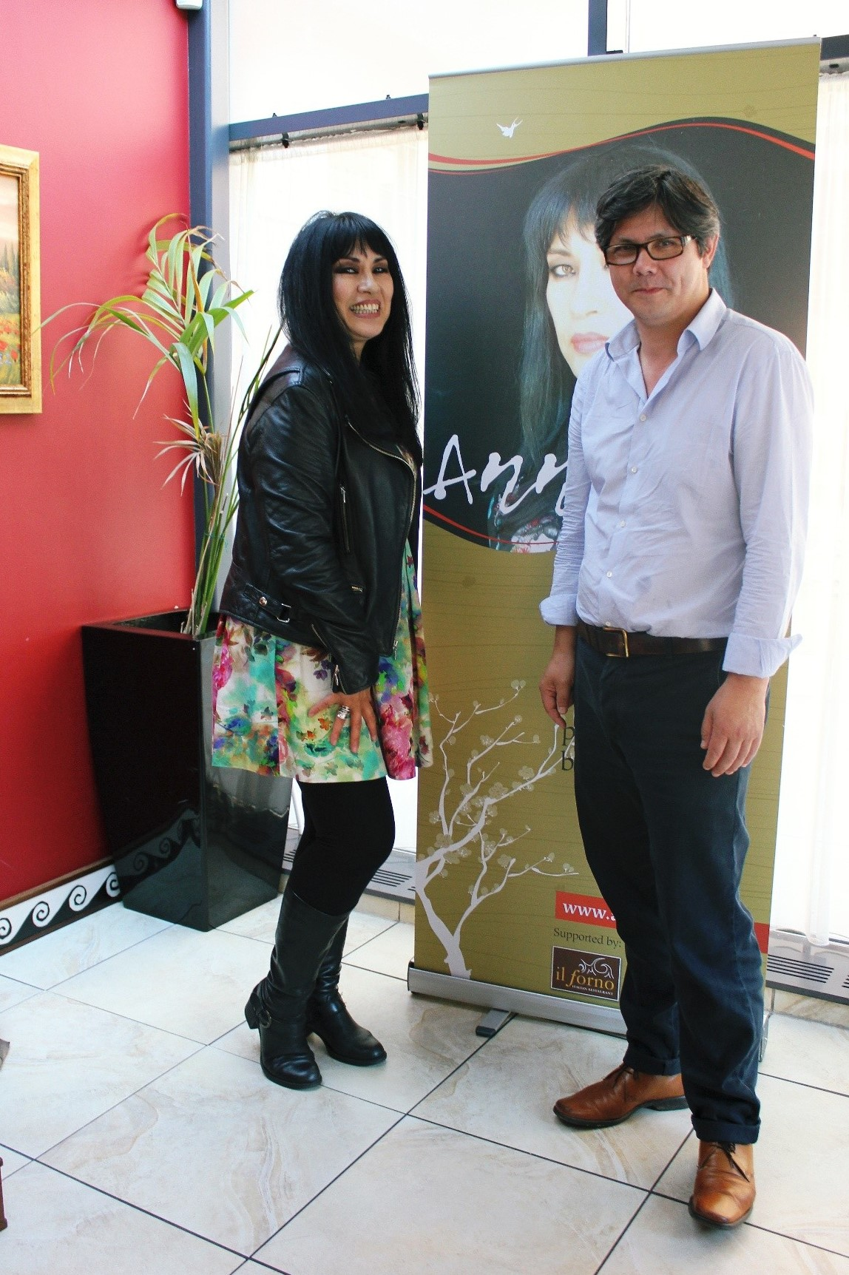
Verbatim Theatre
Providing opportunities for Actors
Anna Chen Poetry Readings

Slide 8
WW1 Public Art Installation
Liverpool BID Commission
The Lyceum Post Office Building
Bold Street, Liverpool

Slide 9
THE BRIEF
To Beautify the building with a design to prevent further damage to the façade and steps.
To enhance the public realm while the building is empty awaiting regeneration
To alleviate the problem of anti-social behavior caused by street drinkers and night clubbers
To make people feel safe and reduce Graffiti and crime
Reduce litter and fly tipping
To work within the limits of a Grade II* listed building

Slide 10
Dulce et Decorum Est
Commemoration of The Battle of the Somme
2016

Slide 11
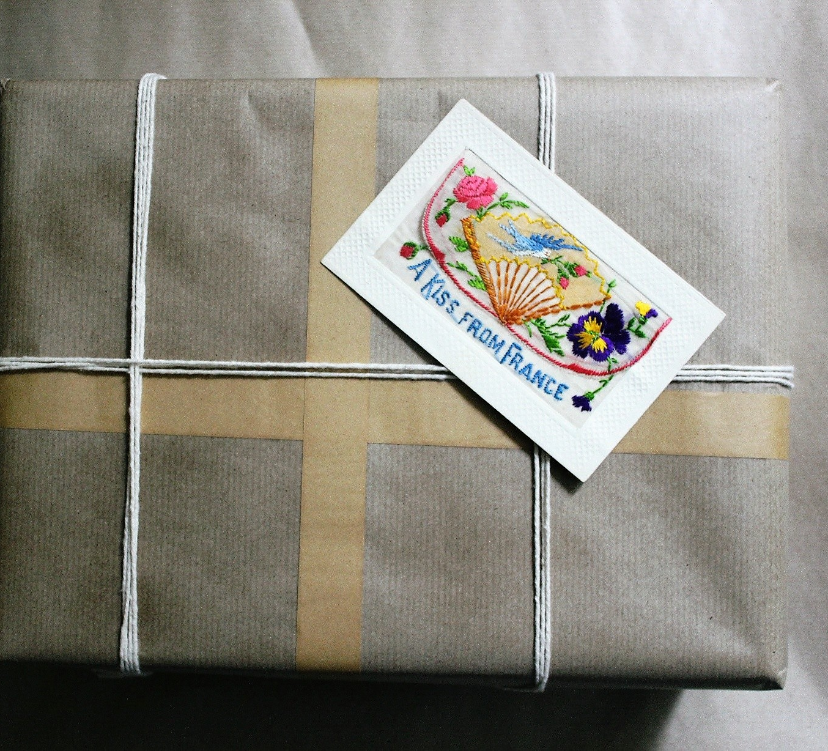
The Idea
To create a design made up of WW1 Correspondence to reflect the Heritage of the building as a Post Office and Reading Rooms.
“Letters from friends and family kept soldiers in touch with the life that they had left behind. Writing home could also be therapeutic. The scale of this correspondence is shown by the fact that the British Army Postal Service alone despatched two billion letters and 114 million parcels over four years”.
Source: The Daily Life of Soldiers
The British Library

Slide 12
Arthur Lloyd - A Liverpool PAL Family Home close to LFC Stadium

Slide 13
100 letters found in the Attic
Correspondence between Arthur Lloyd, his mother, sister Maud, little brother Bertie and
Sweetheart Cissie
Dating from 1914 - 1916.
The letters were found decades later by a new owner of 50 Faraday Street, Liverpool
Held at the Bill Sergeant Liverpool Pals Archive Collection

Slide 14
Knowlsey Hall and Estate Training in preparation for conflict Source: Merseyside at War 1914

Slide 15
The Art Installation

Slide 16
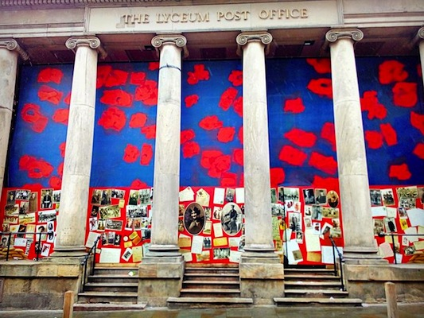

Slide 17
Detail of Centre Panels Arthur Lloyd and his Sweetheart Cissie

Slide 18
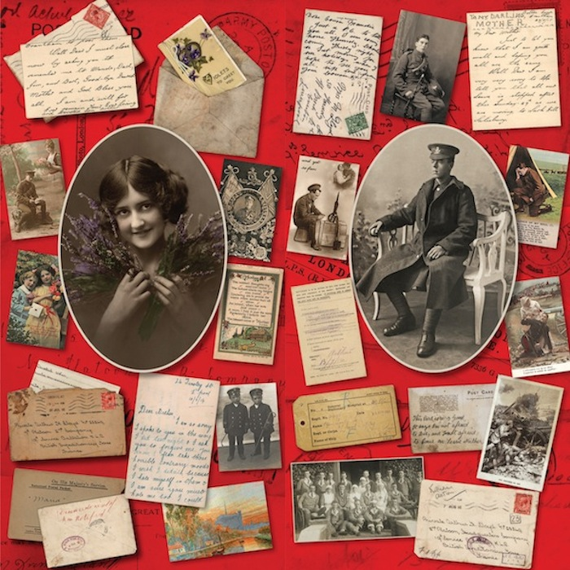

Slide 19
Postcards
Liverpool John Moores University Contemporary Archive and a call out to families in Merseyside provided an insight into postcard design in WW1

Slide 20
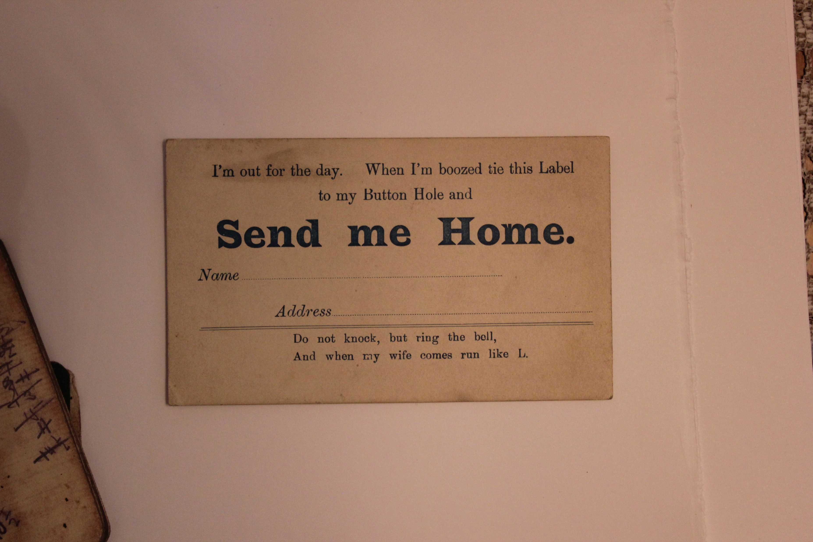

Slide 21
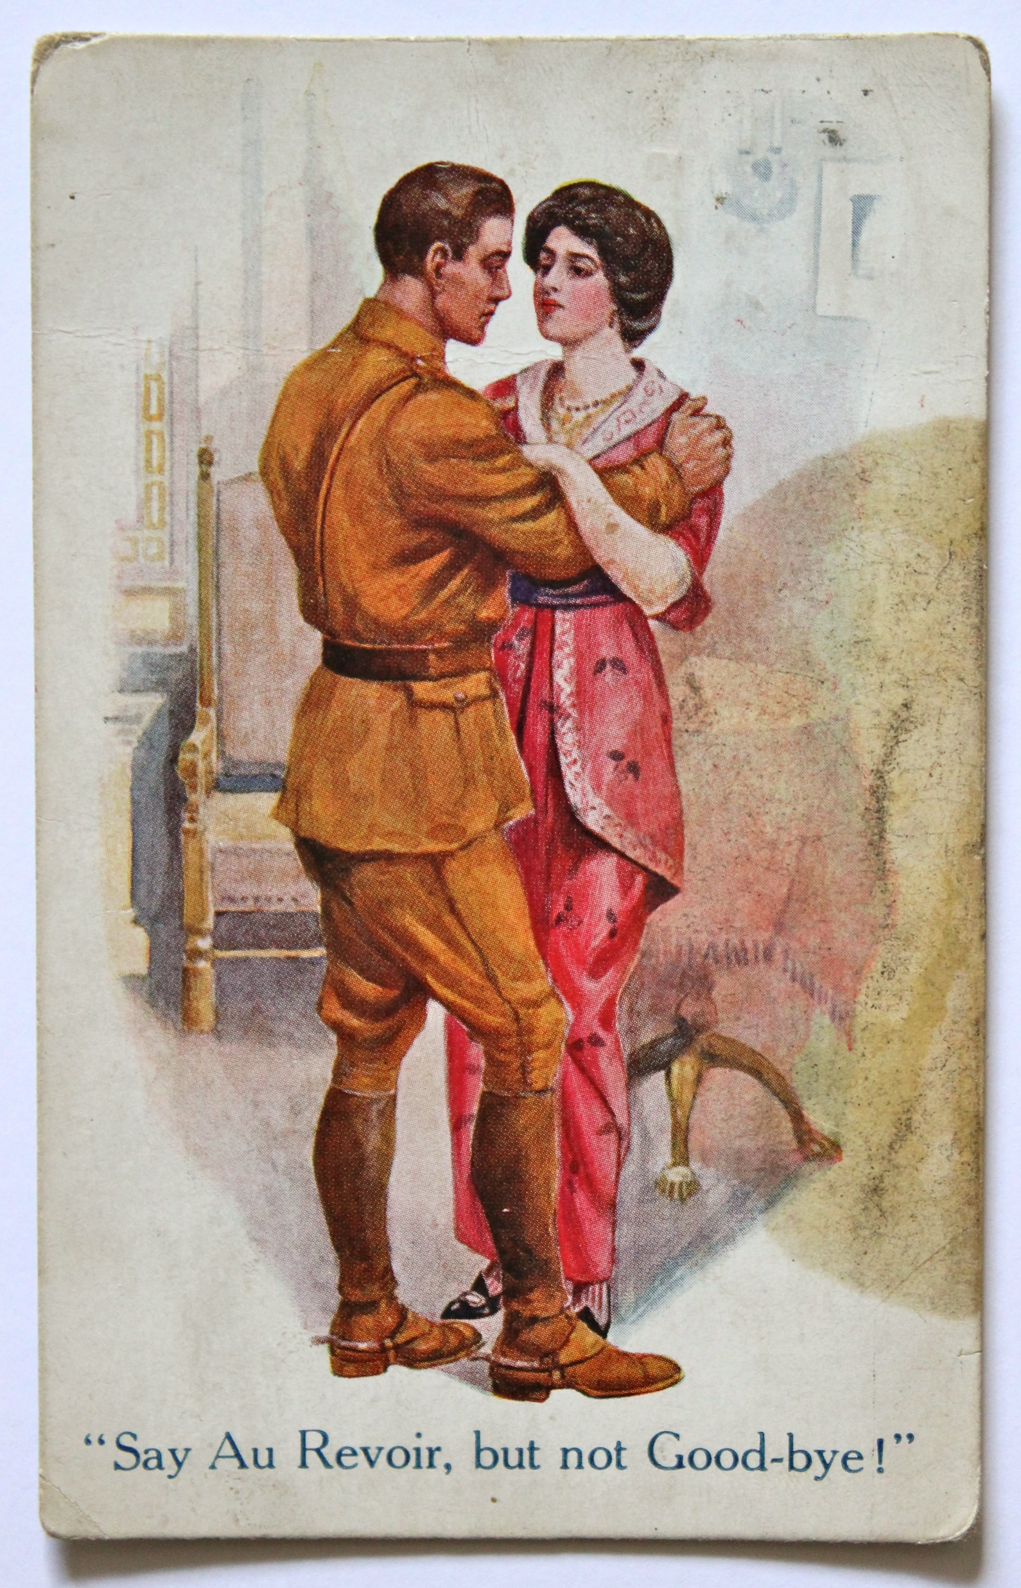

Slide 22
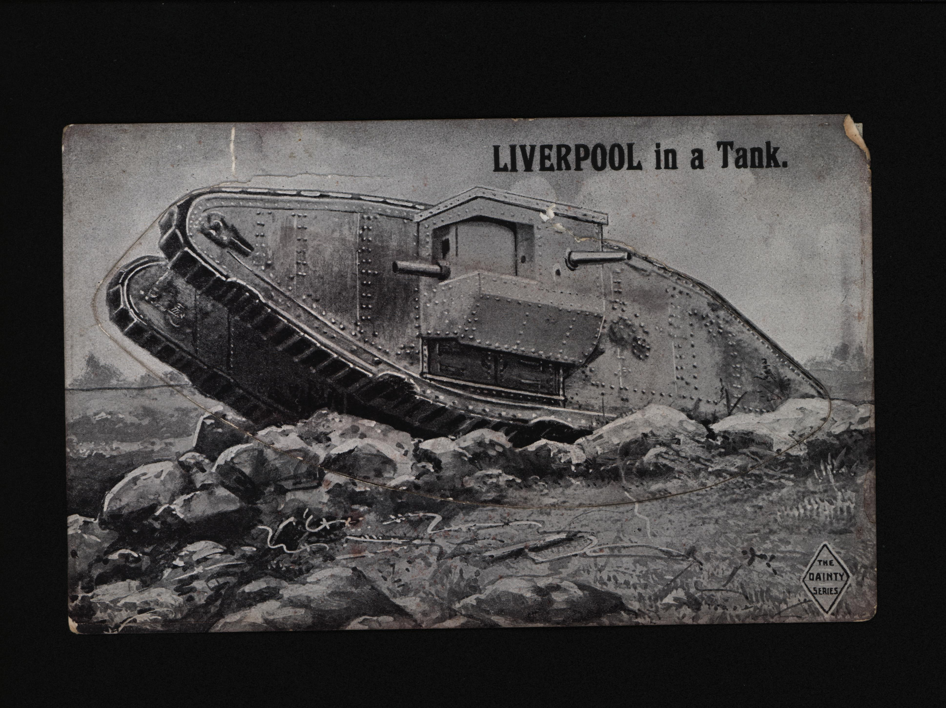

Slide 23
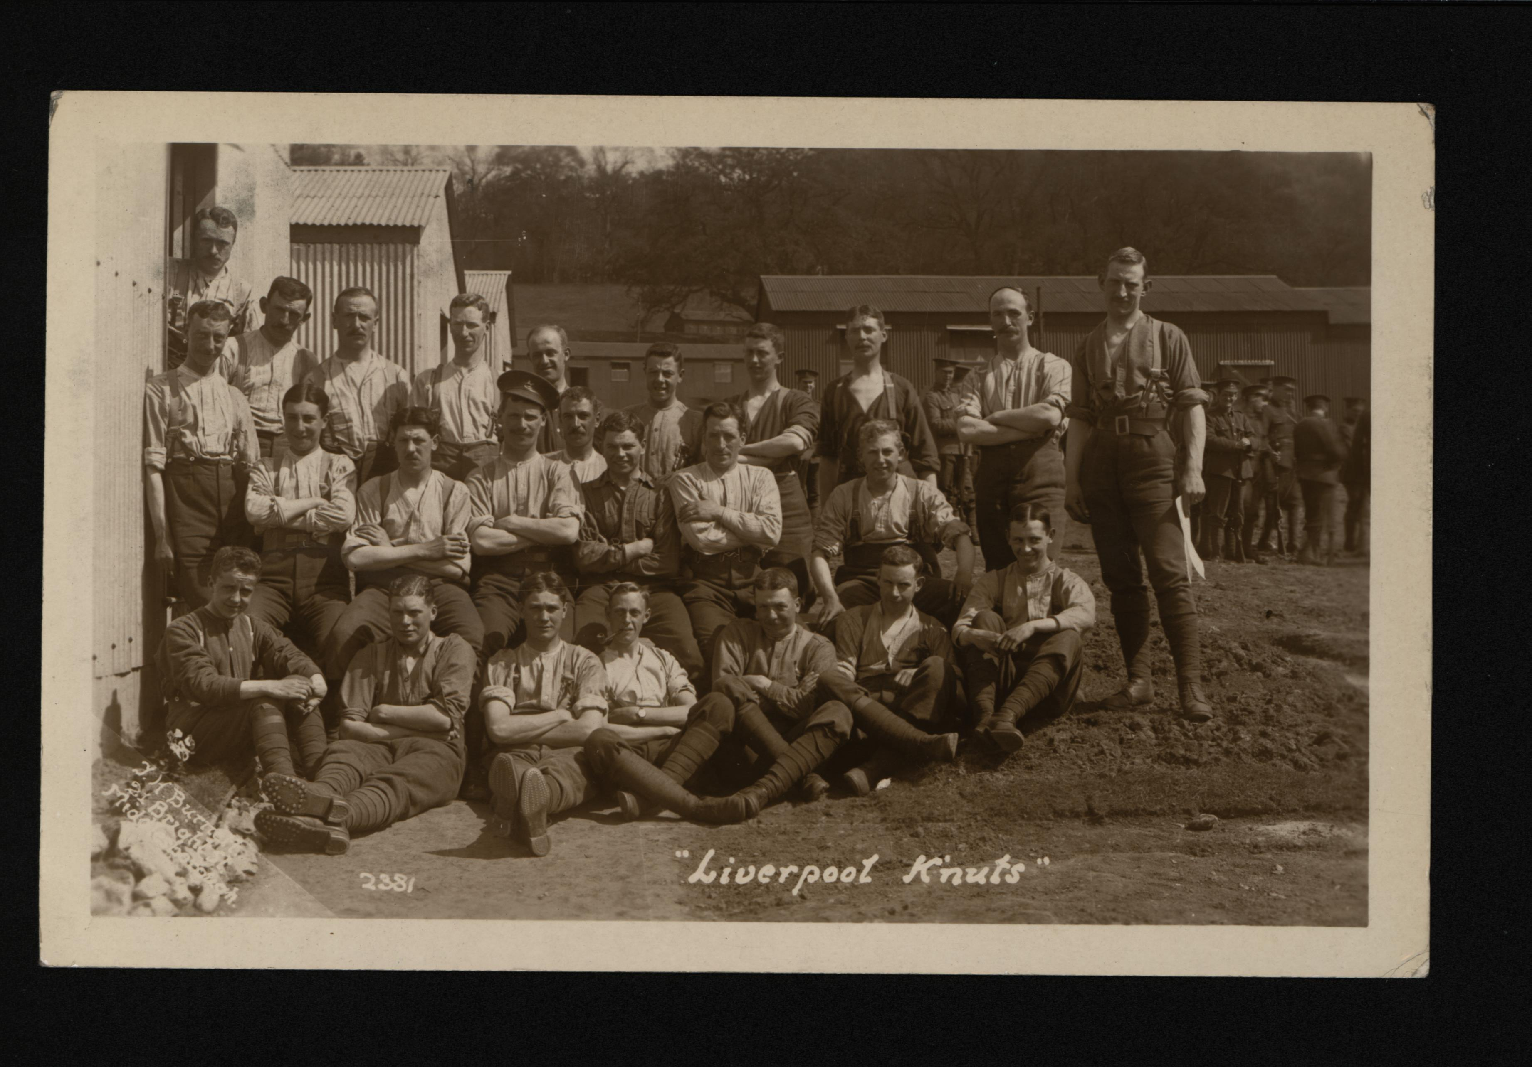

Slide 24
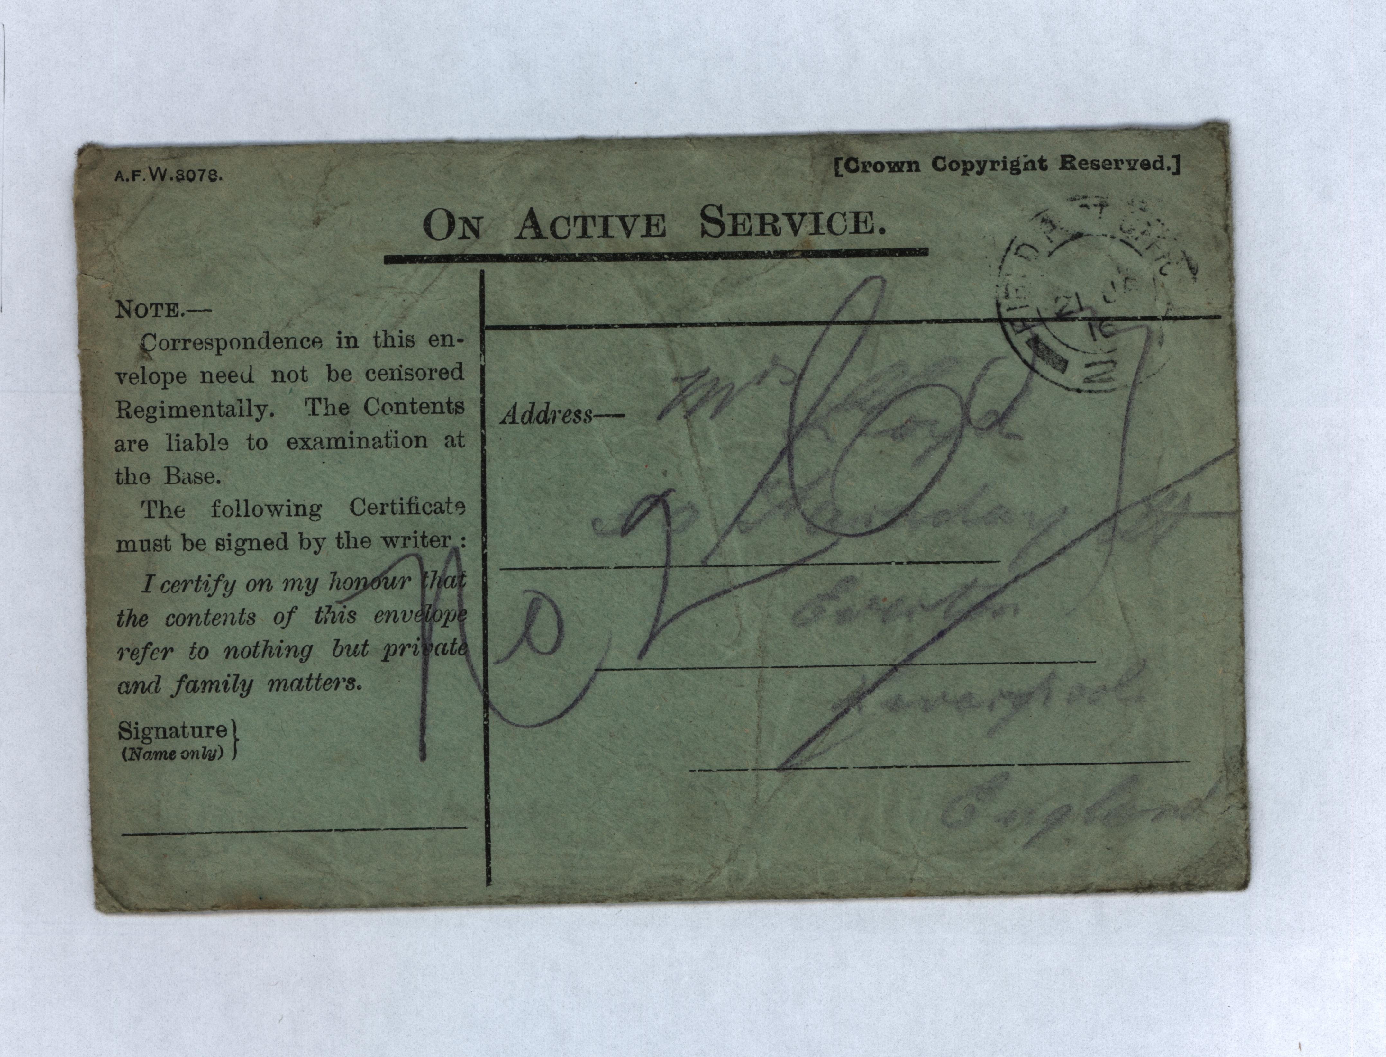

Slide 25
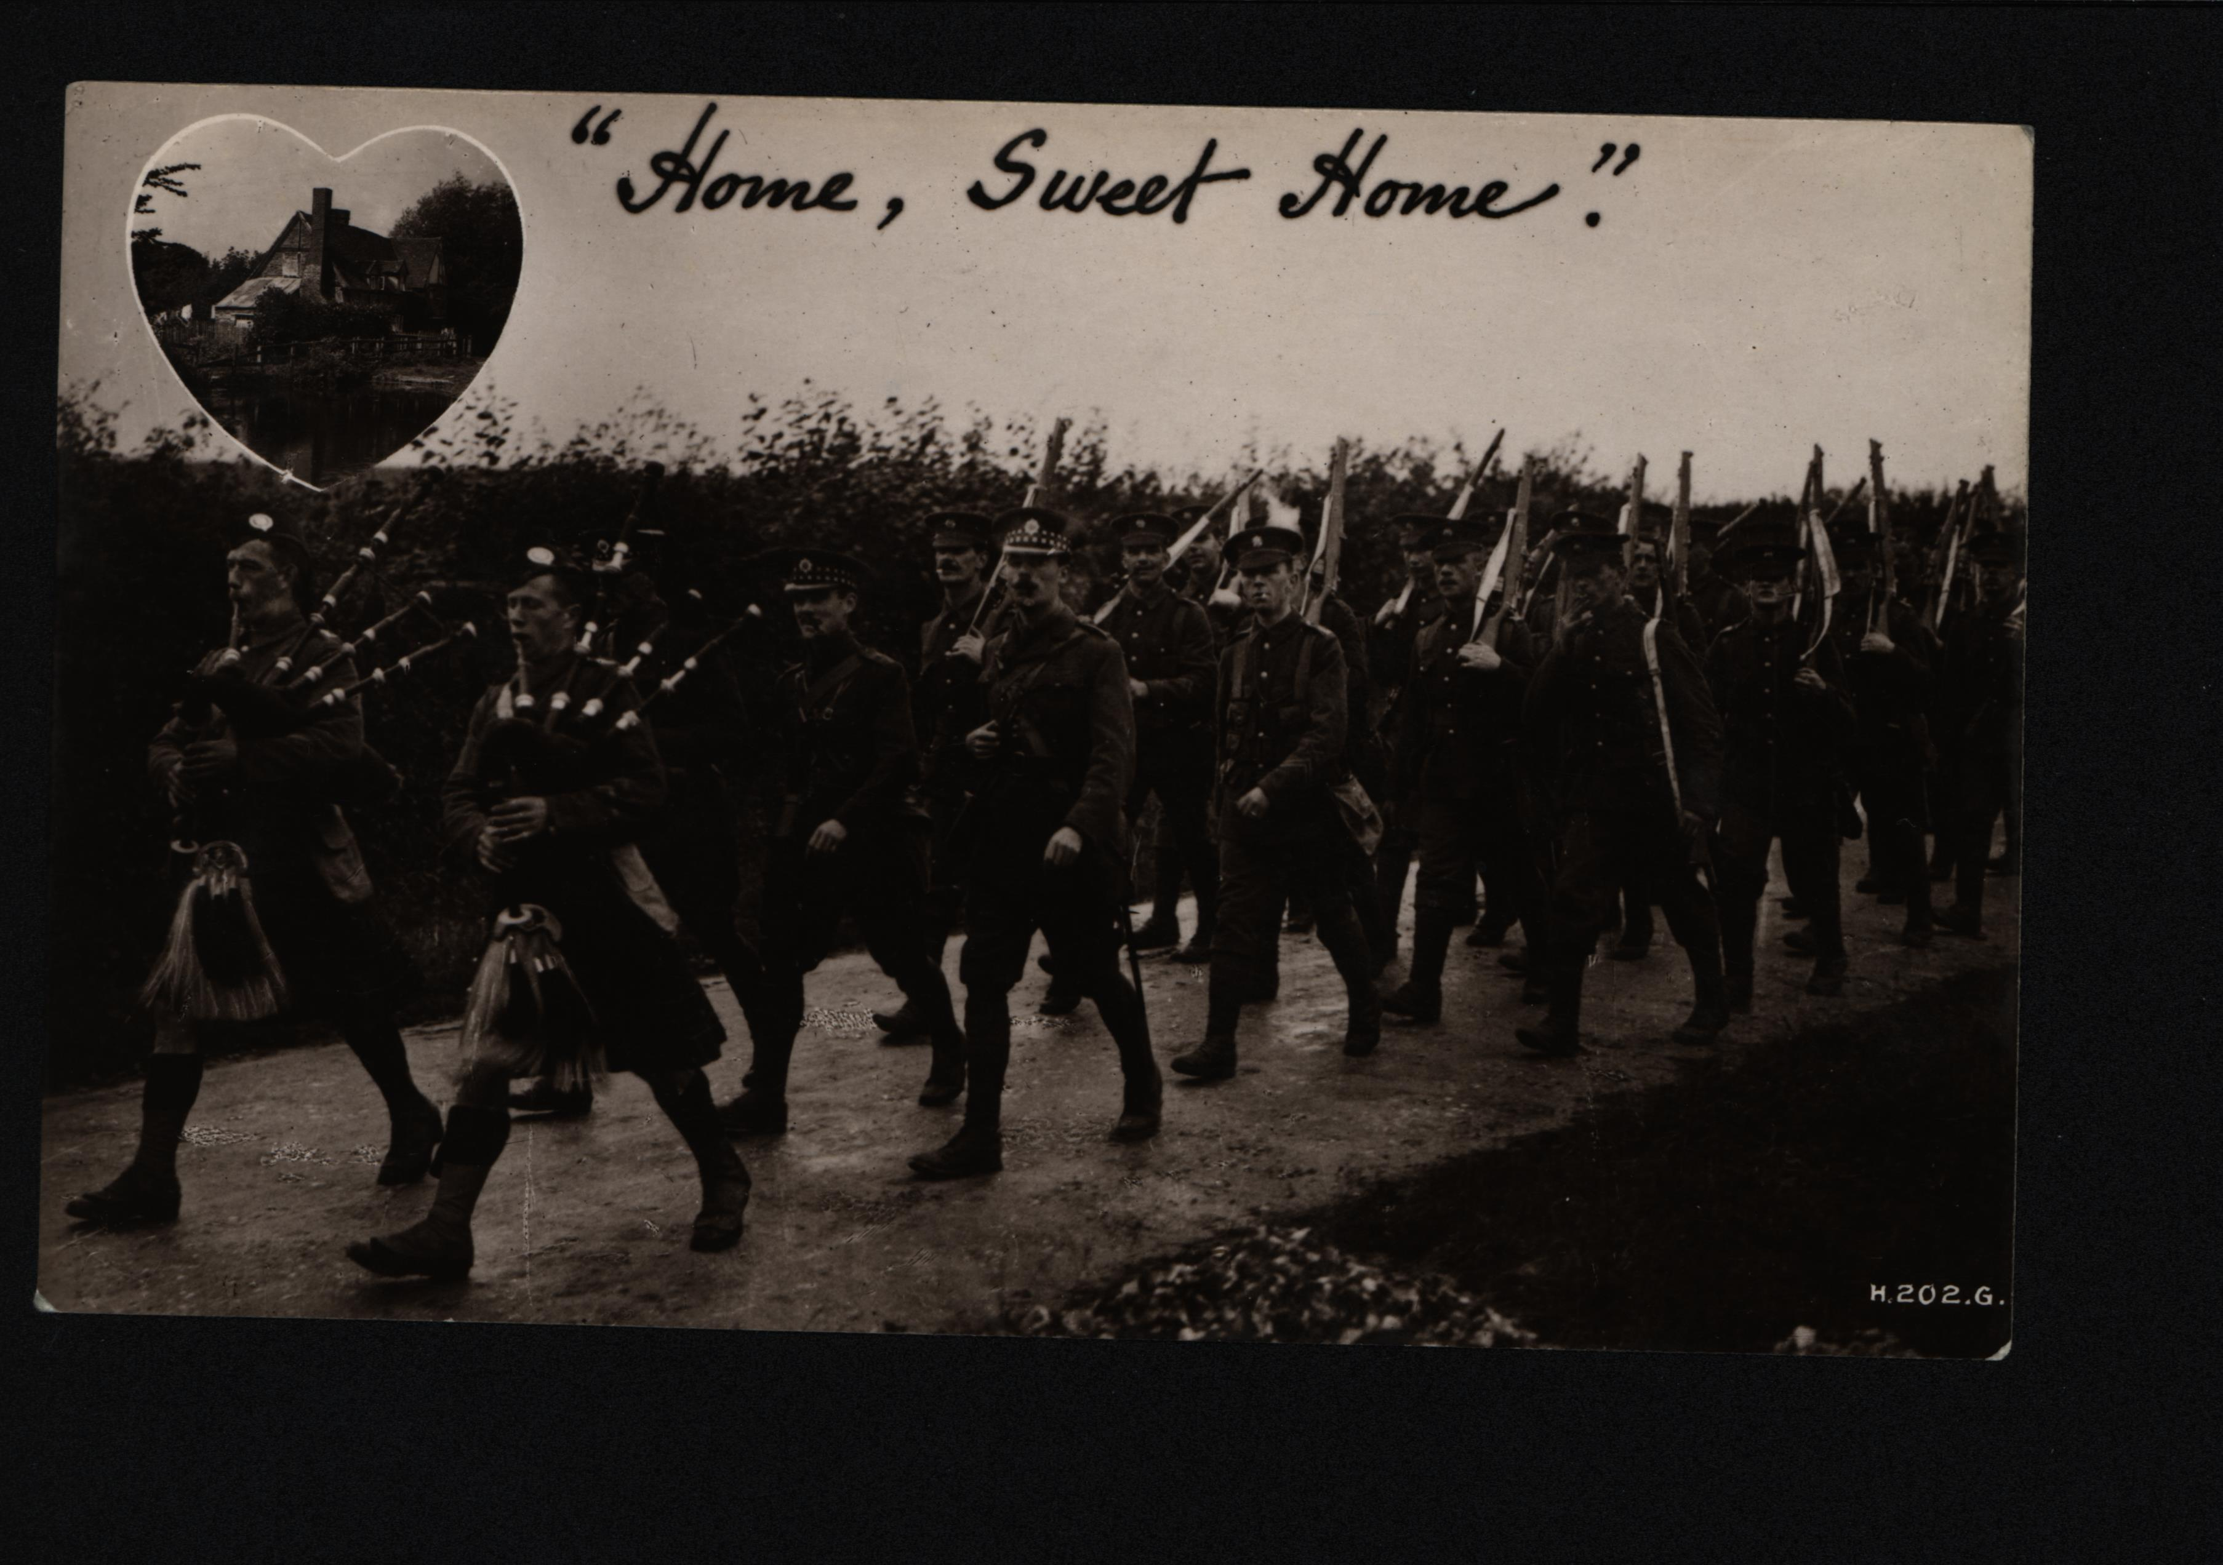

Slide 26
Selection of Arthur Lloyd Letters
1914 -1916

Slide 27
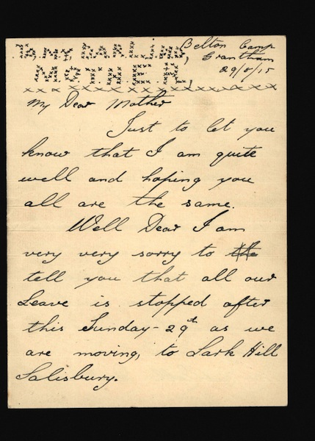

Slide 28
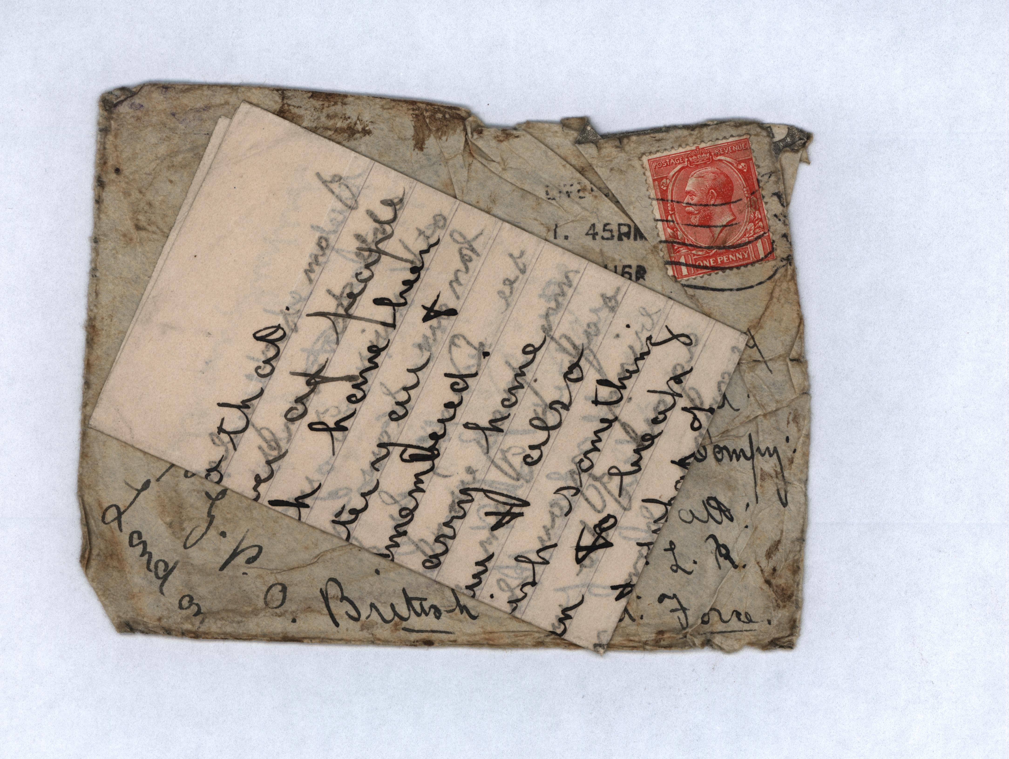

Slide 29
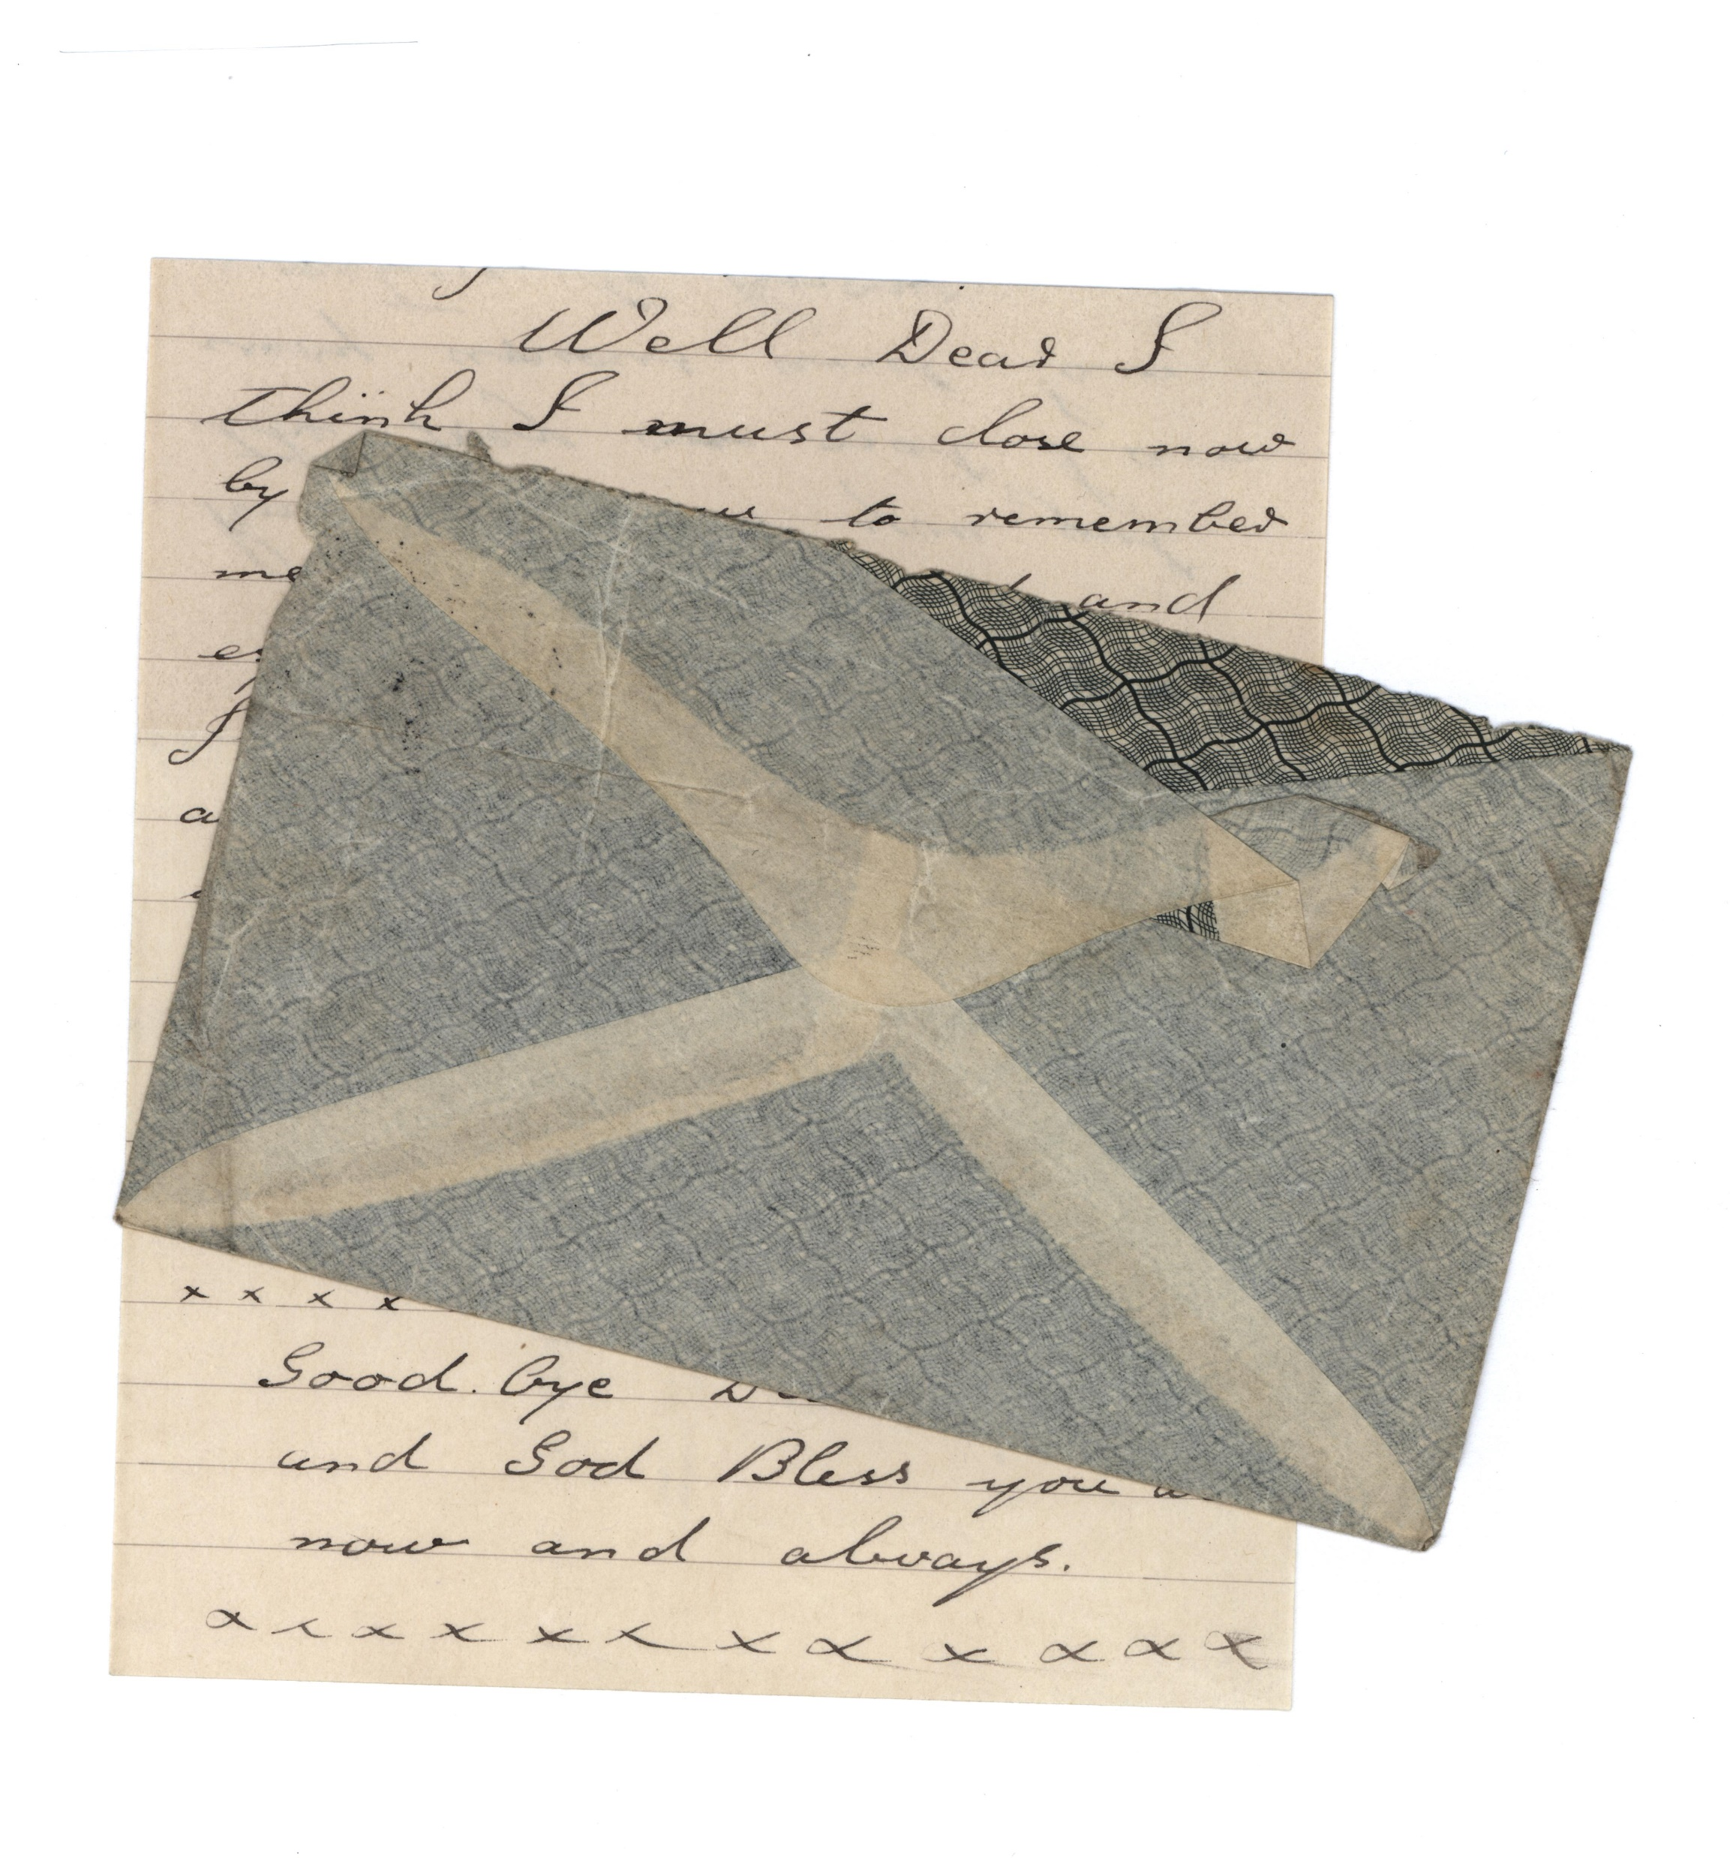

Slide 30
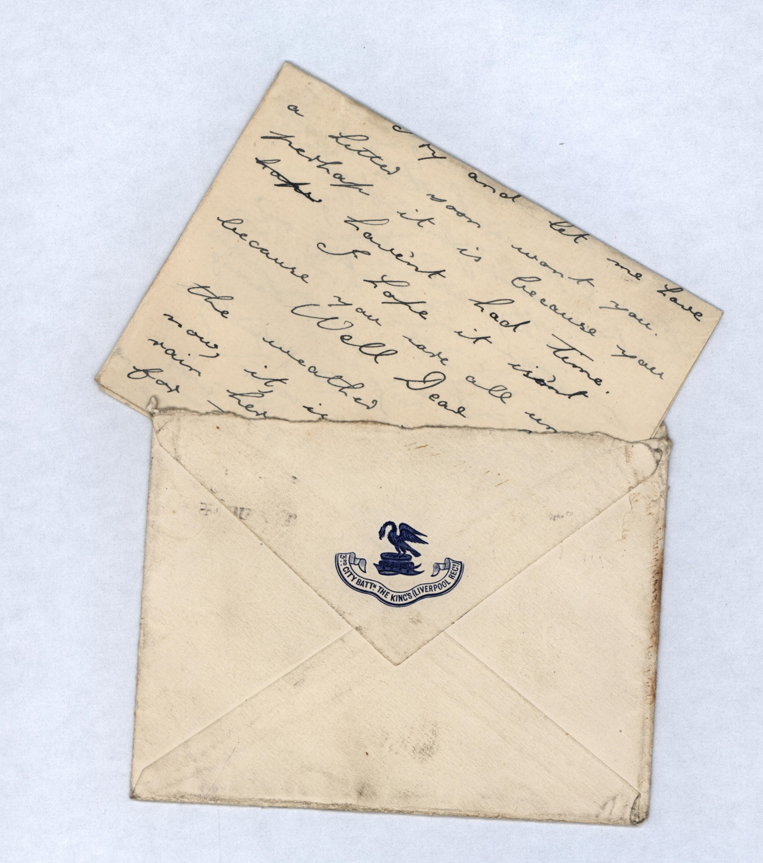

Slide 31
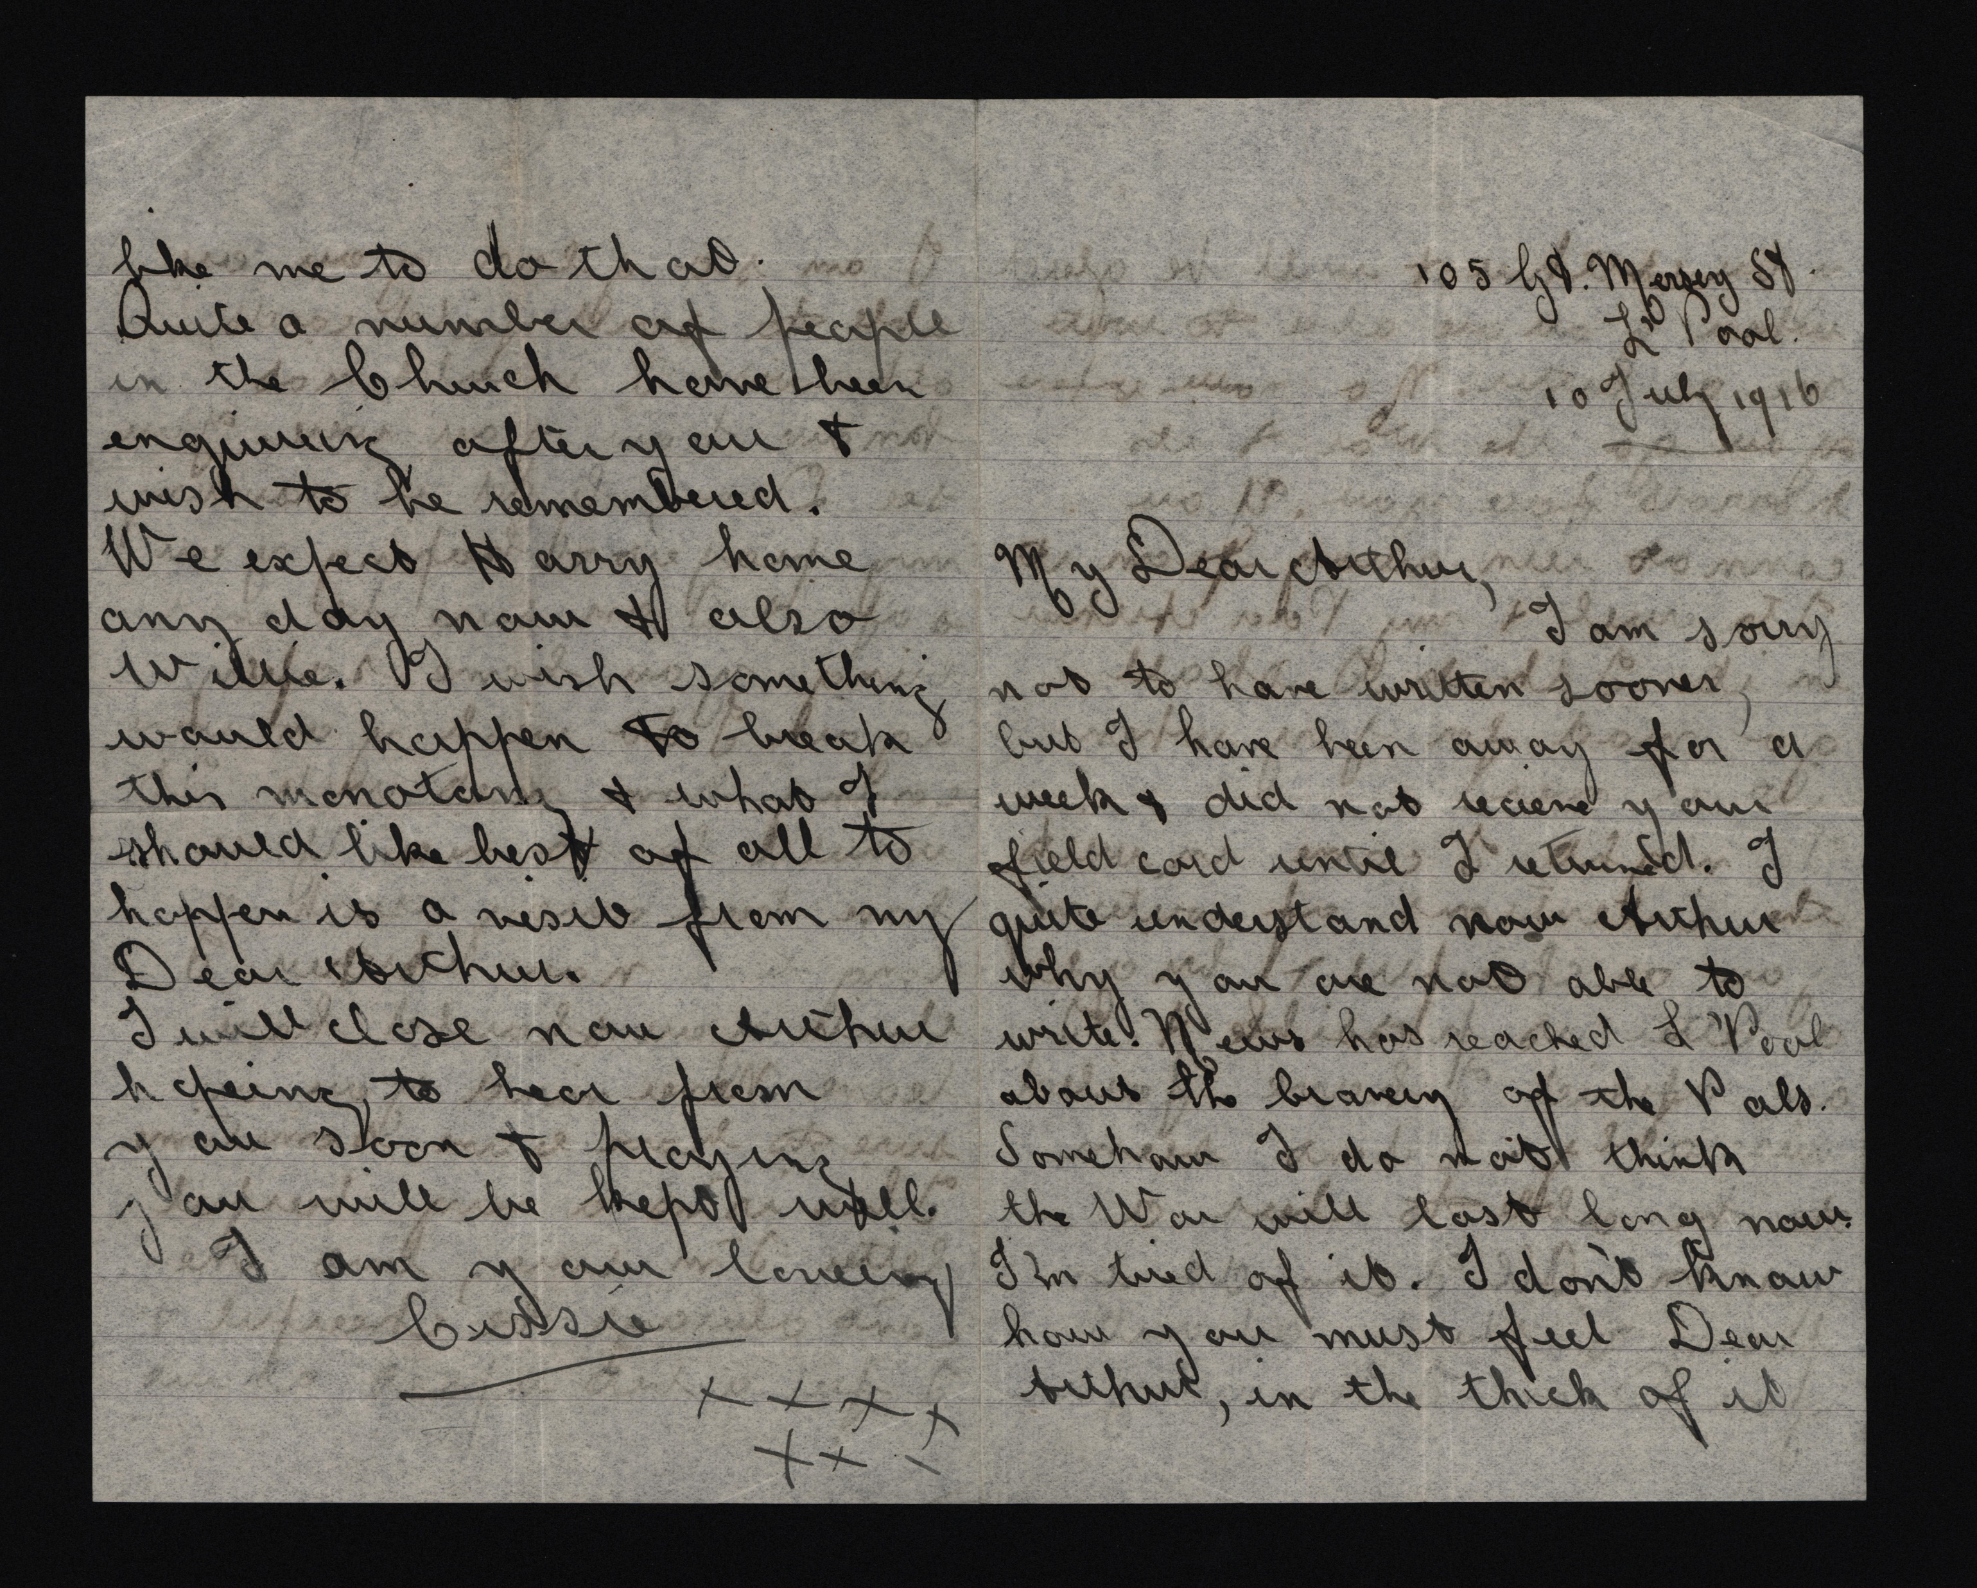

Slide 32
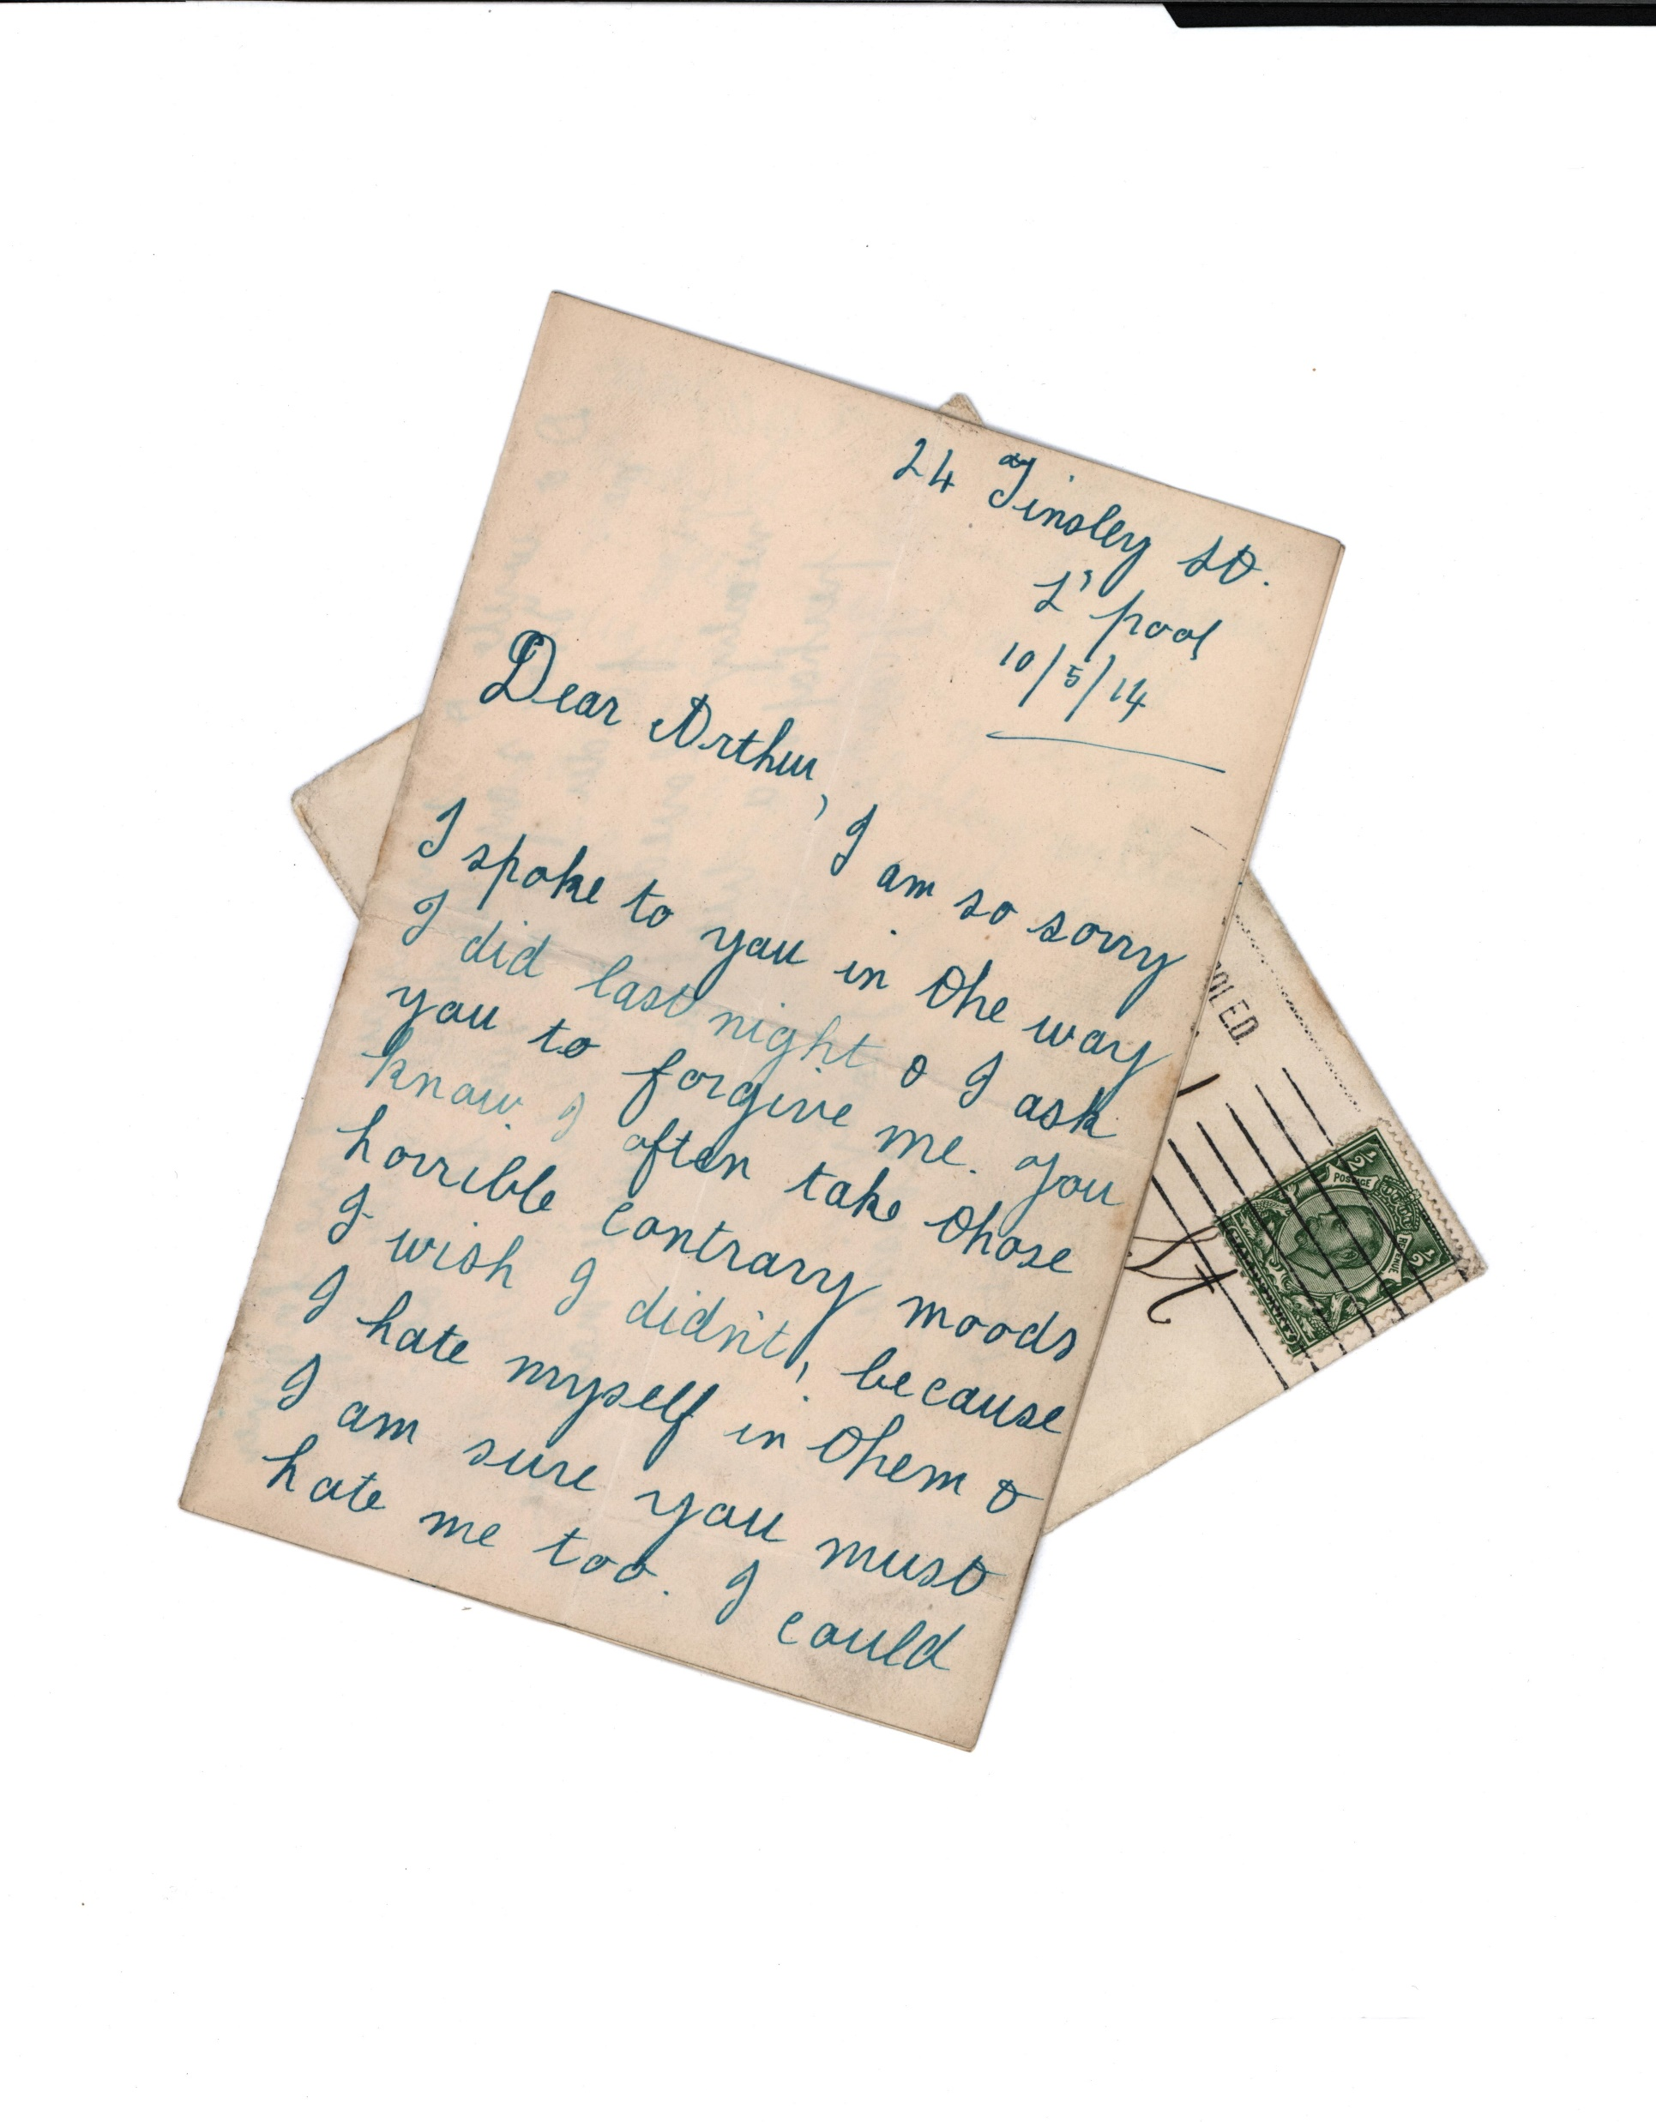

Slide 33
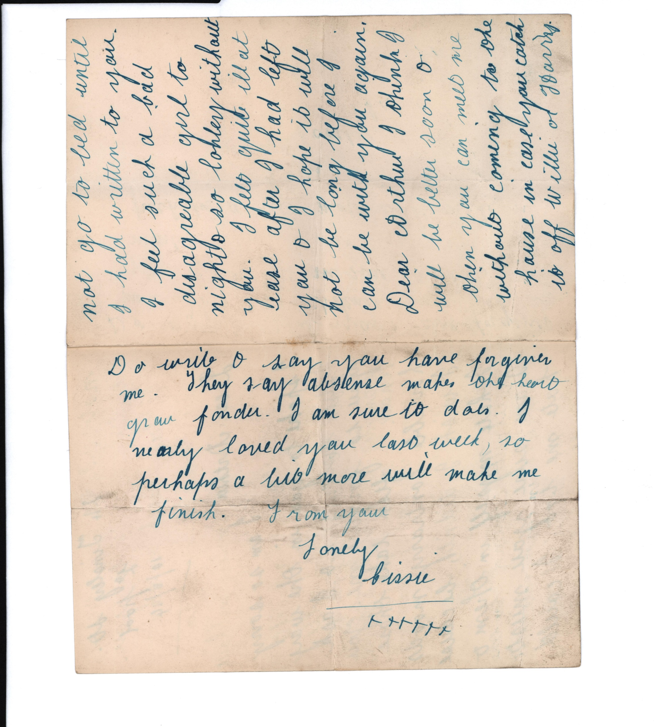

Slide 34
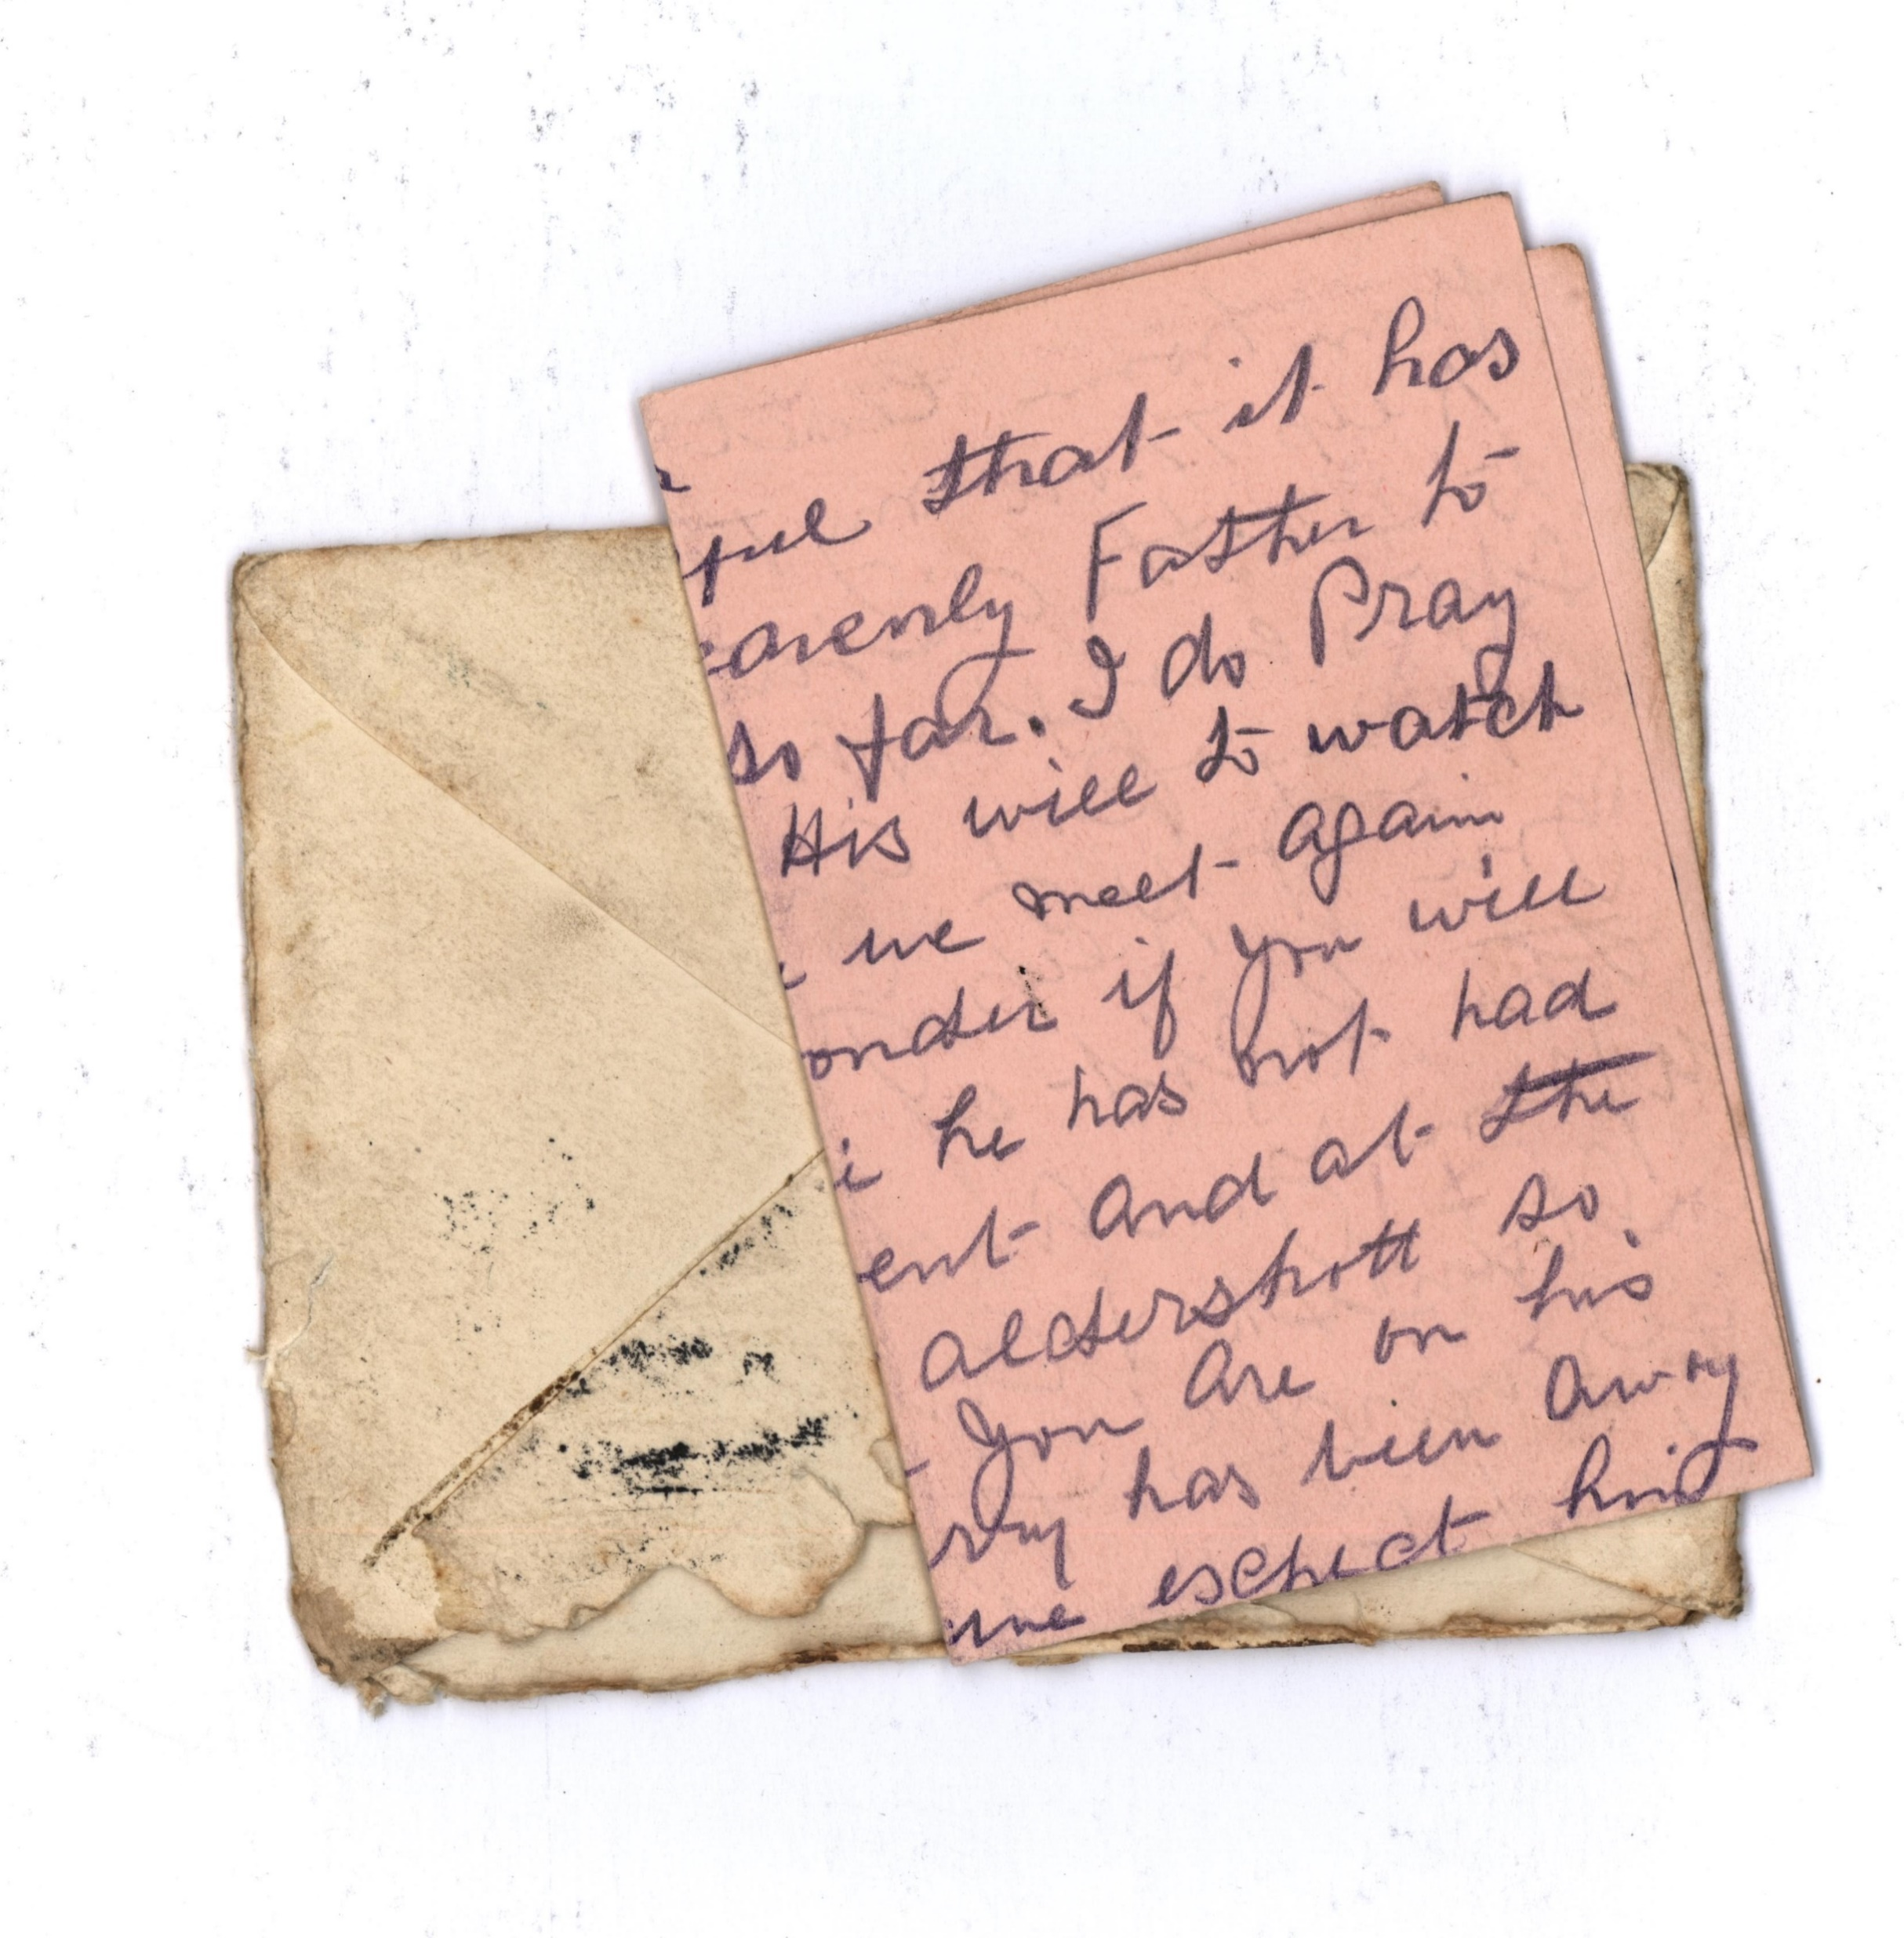

Slide 35
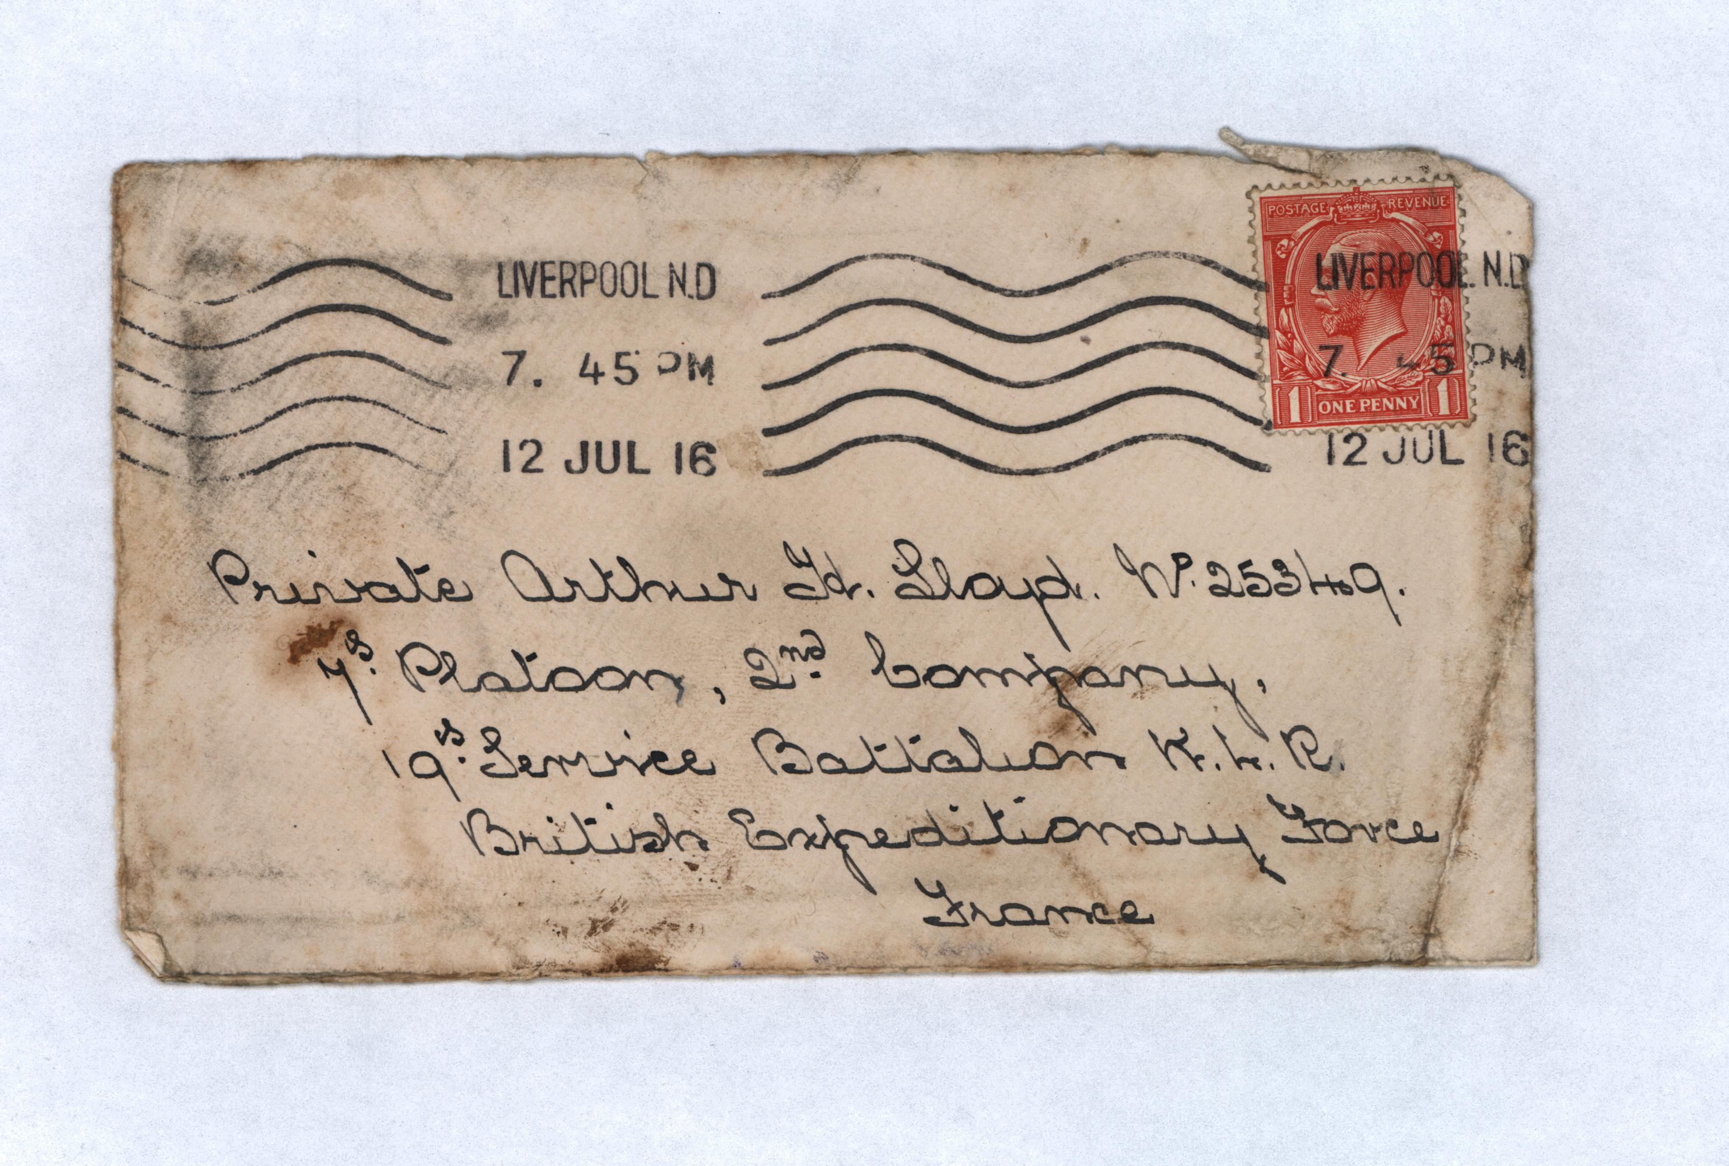

Slide 36
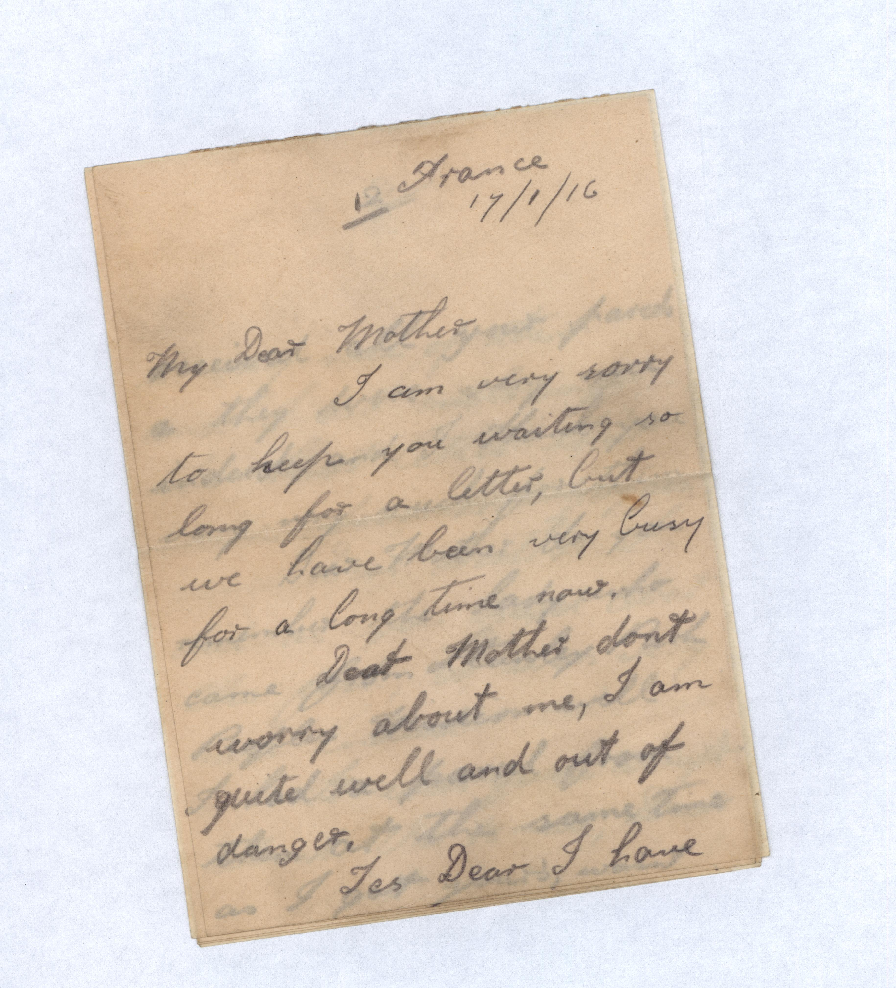

Slide 37
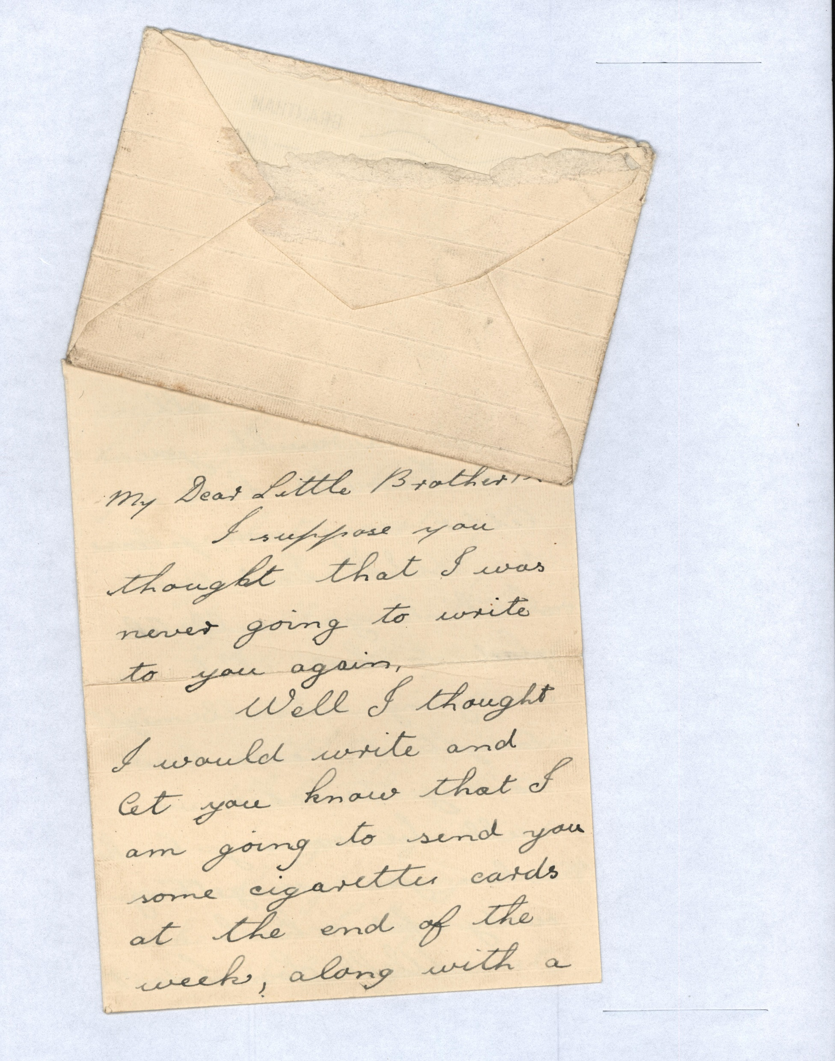

Slide 38
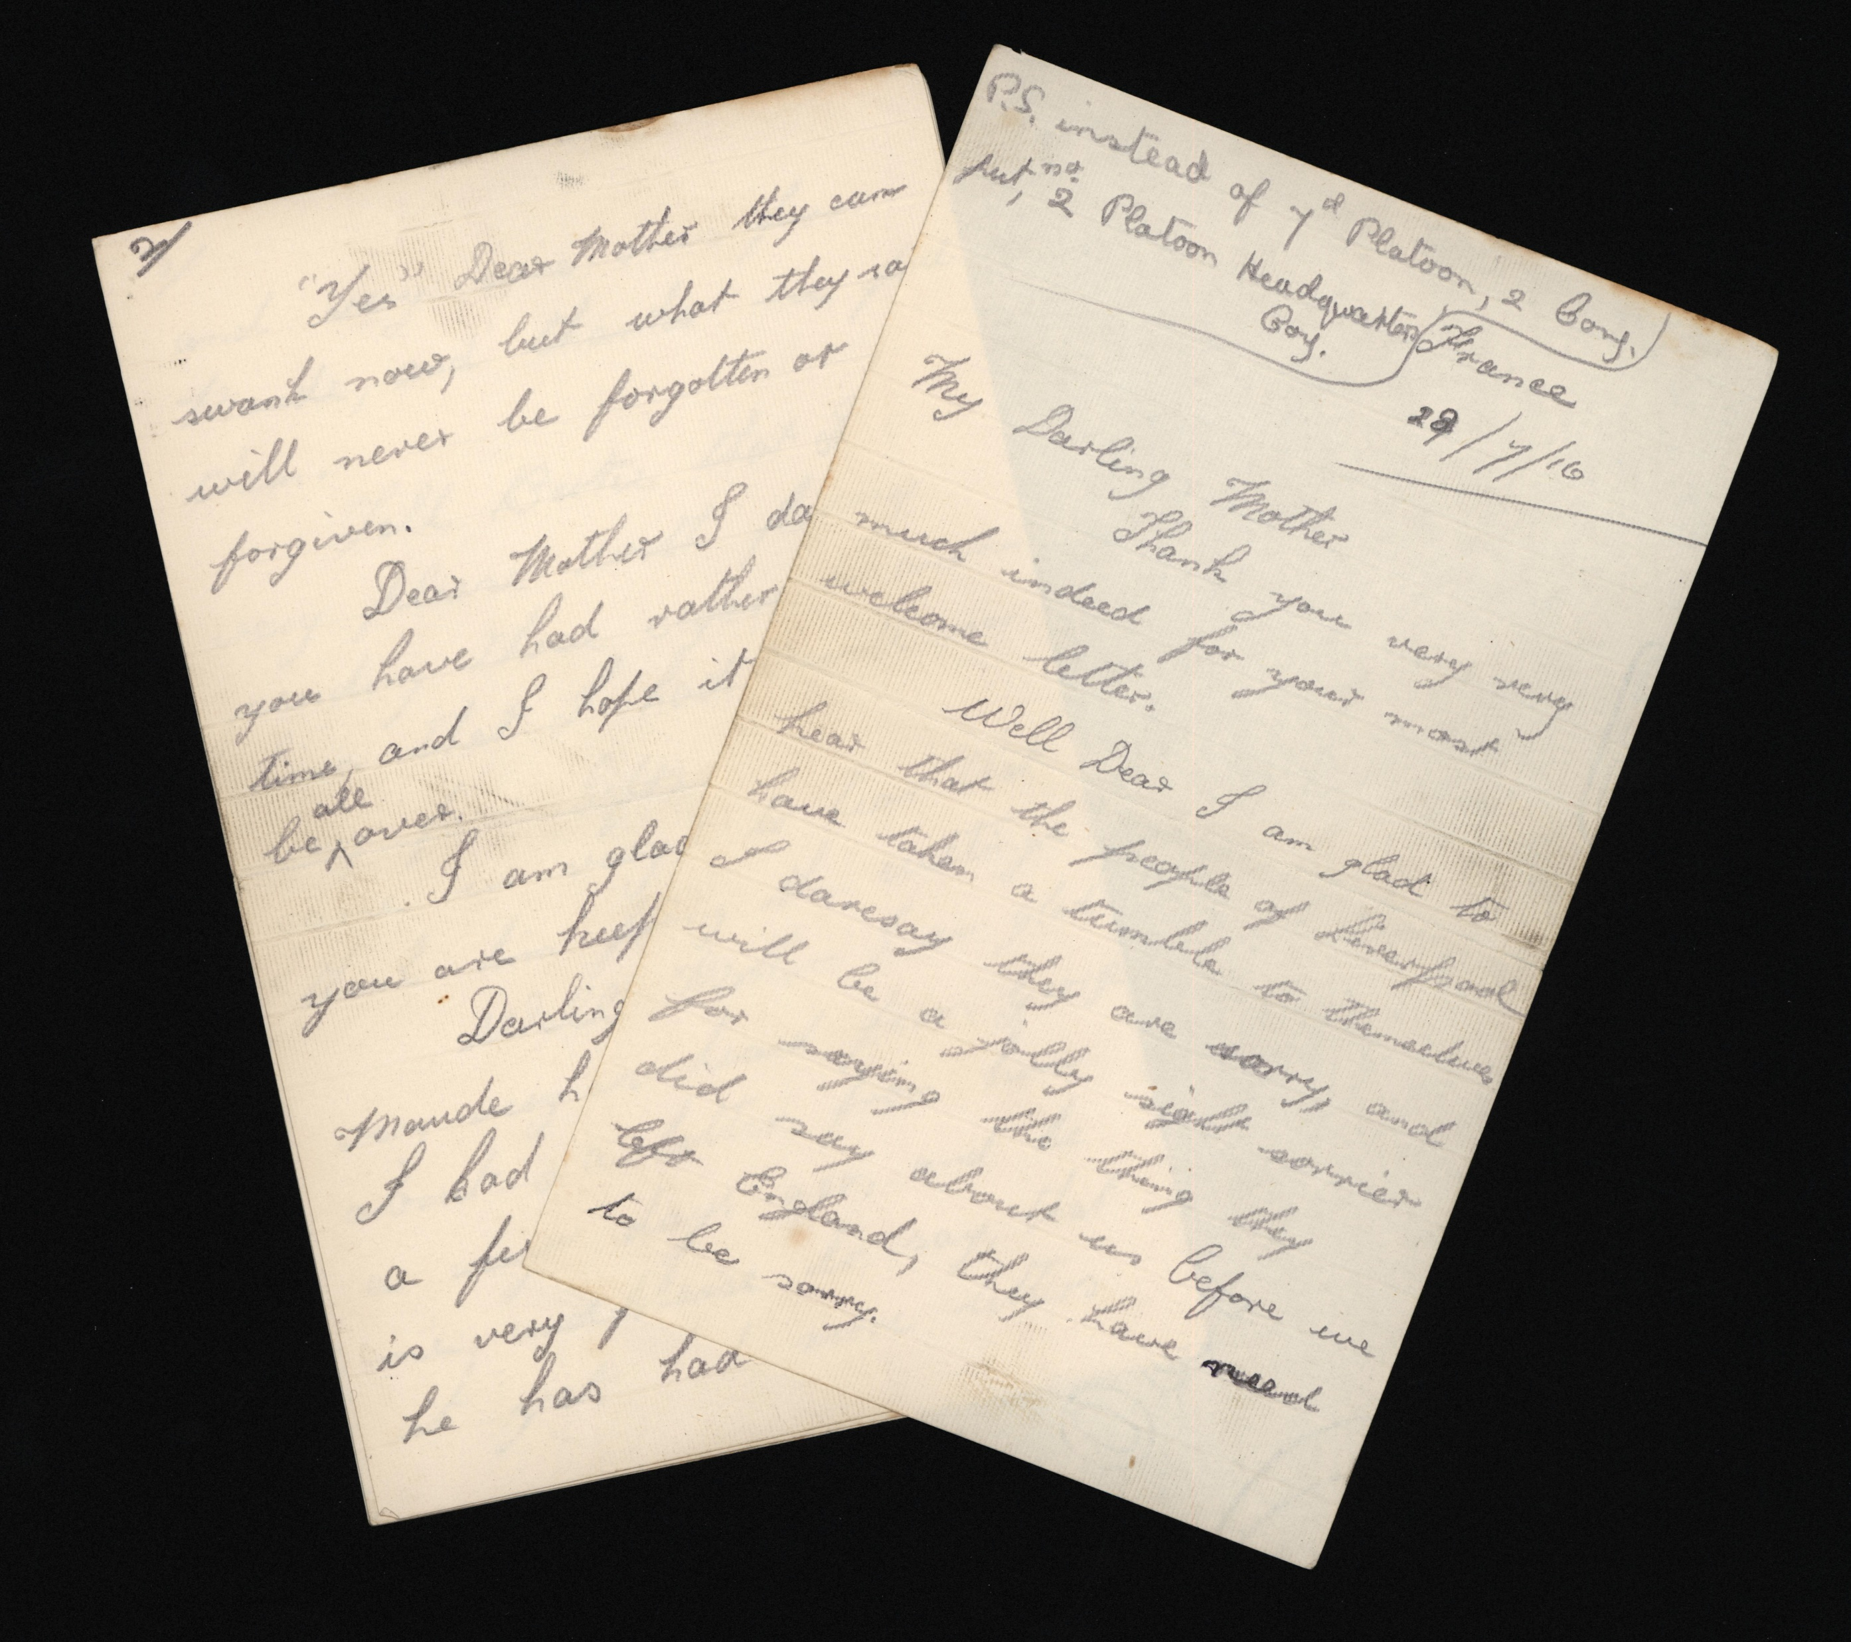

Slide 39
Arthur Lloyd was Killed in Action on the 30th July 1916 Aged 20
A bloodstained letter from his sister was discovered in his pocket.

Slide 40
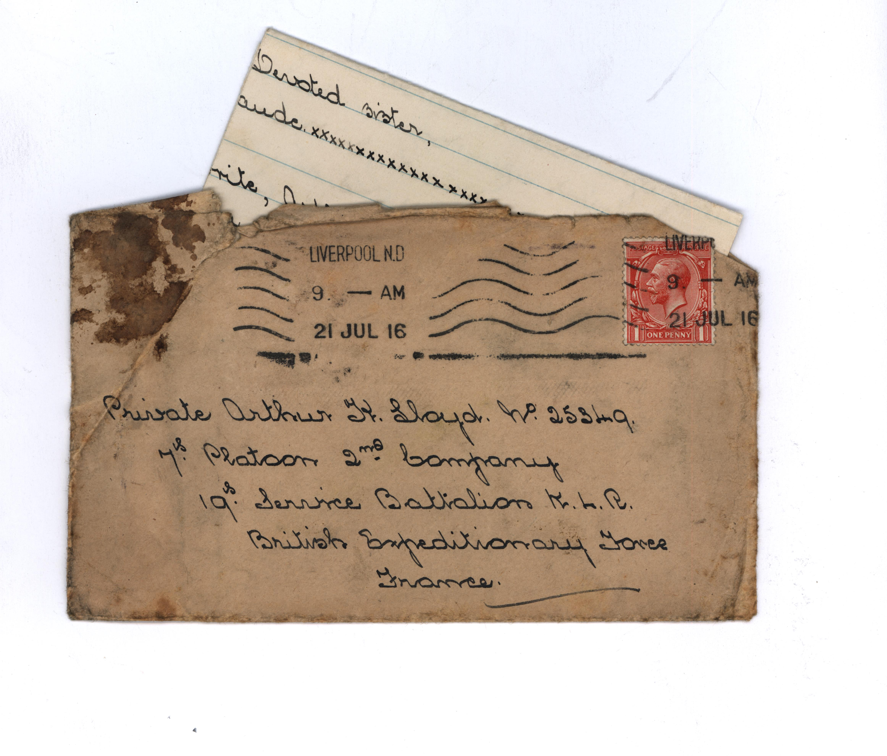

Slide 41
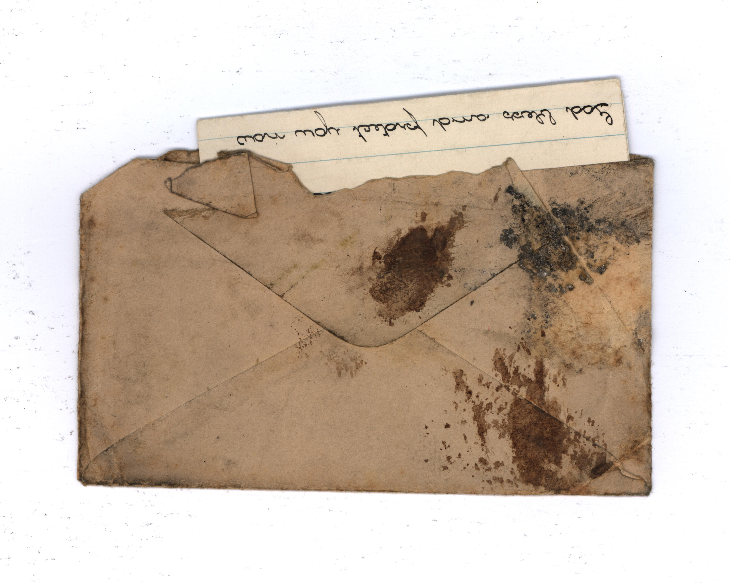

Slide 42
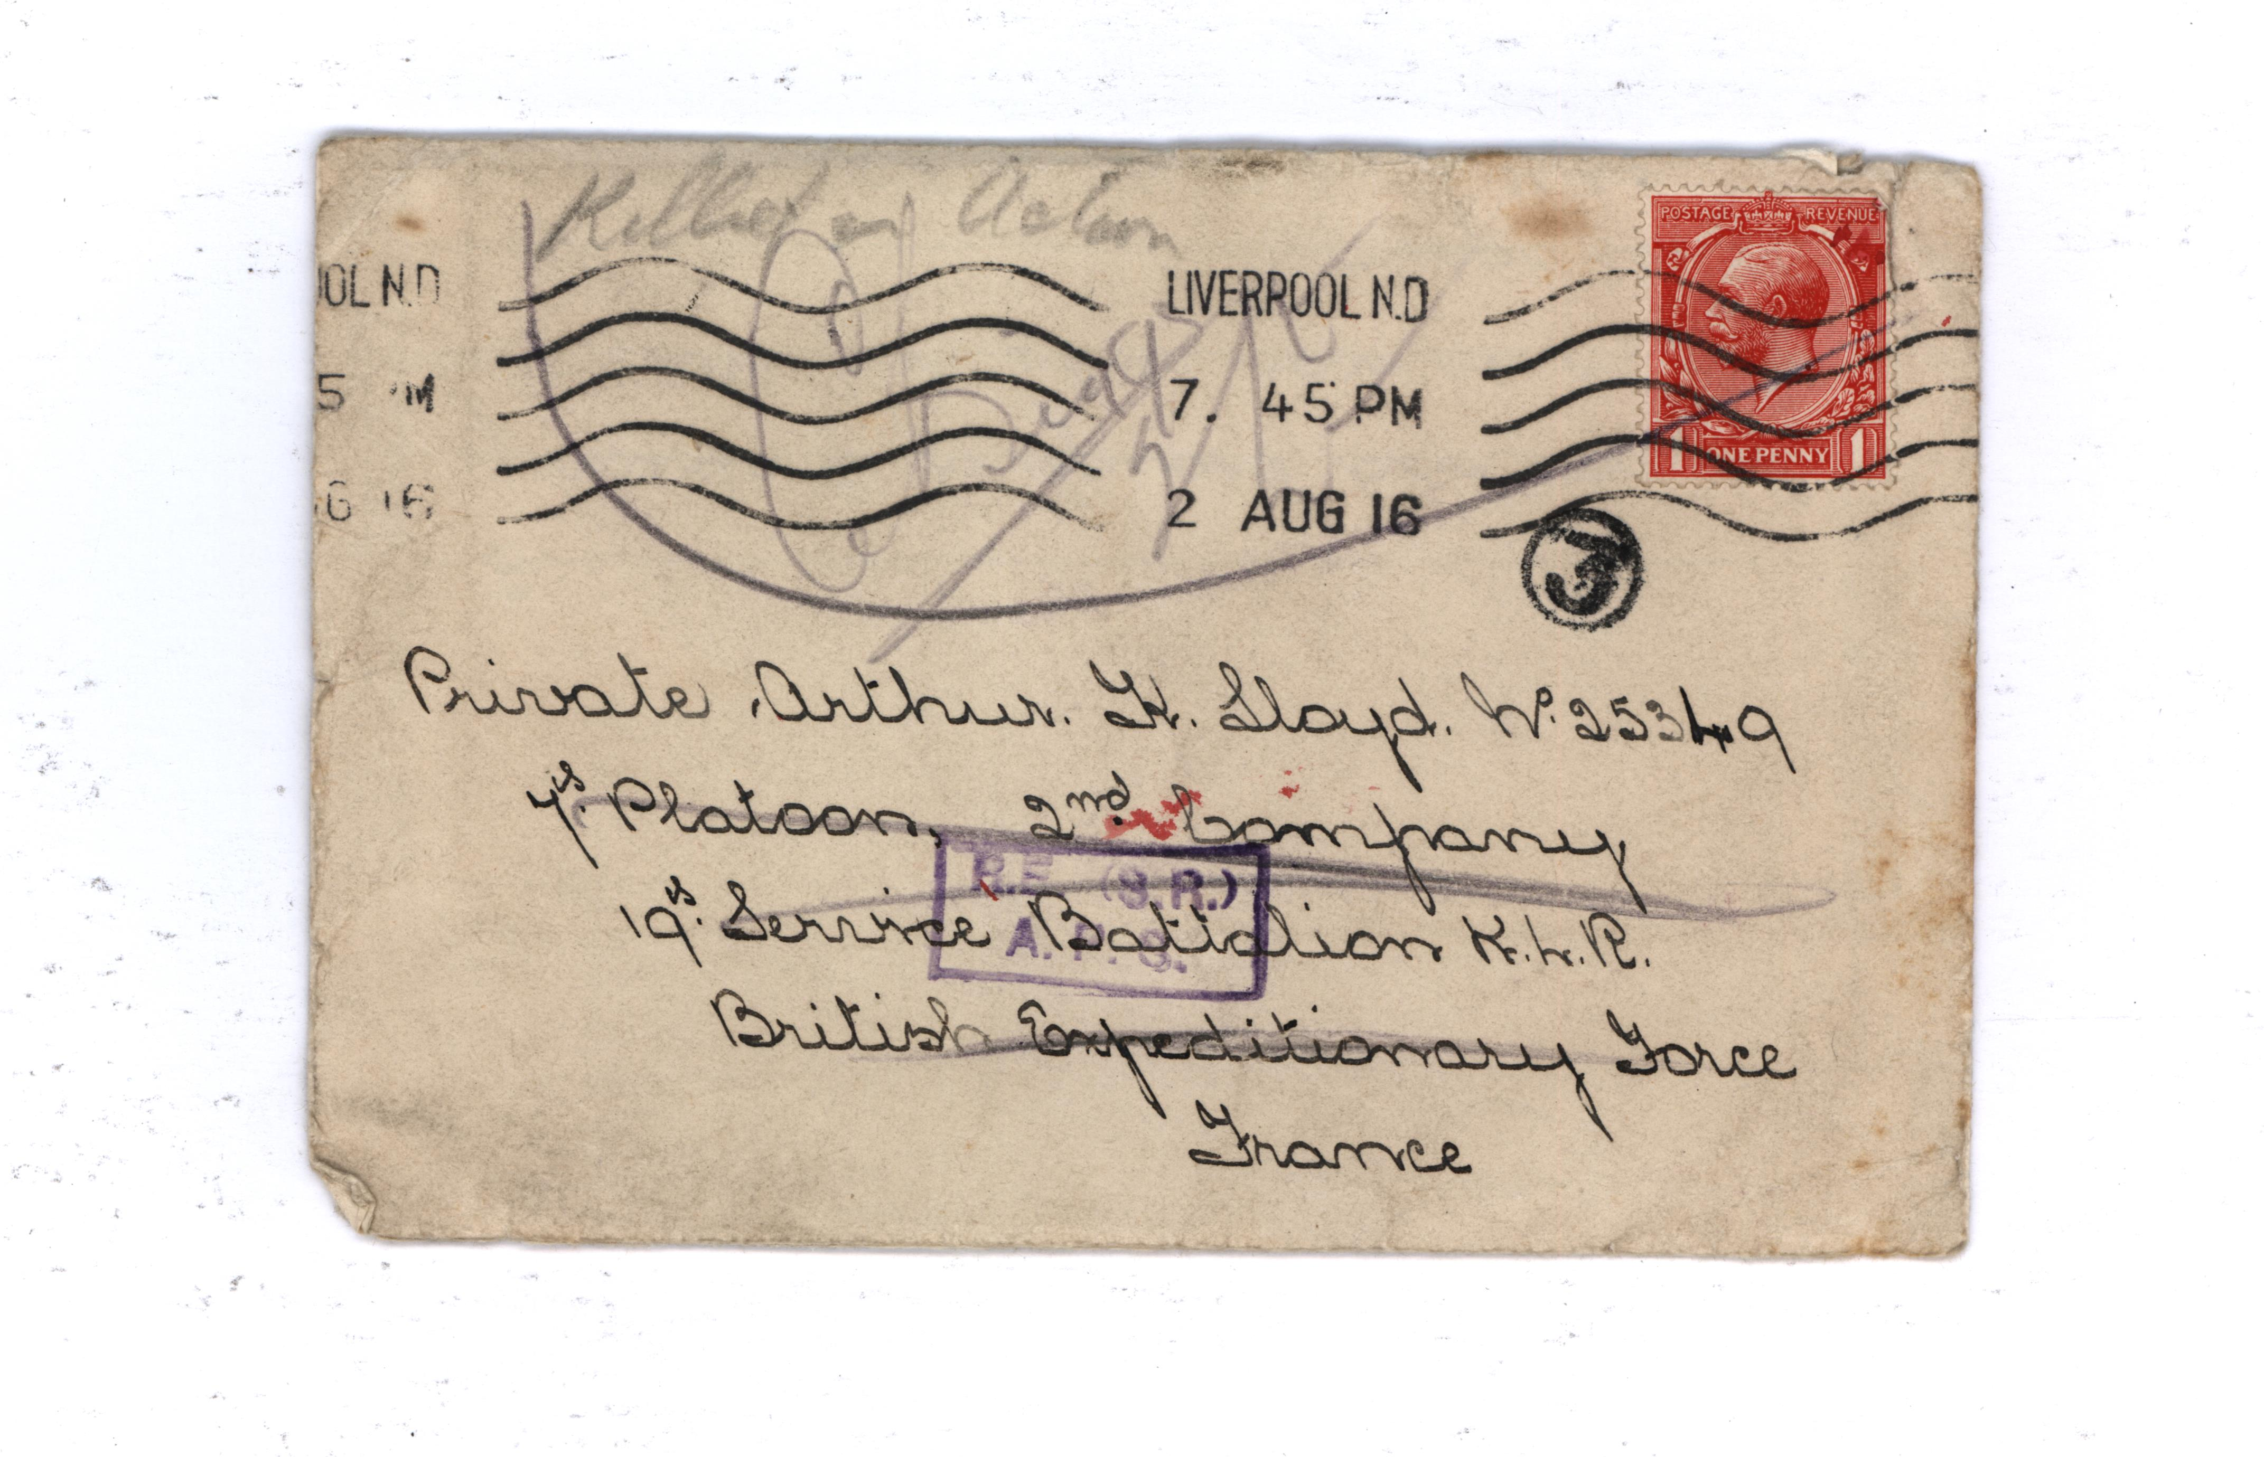

Slide 43
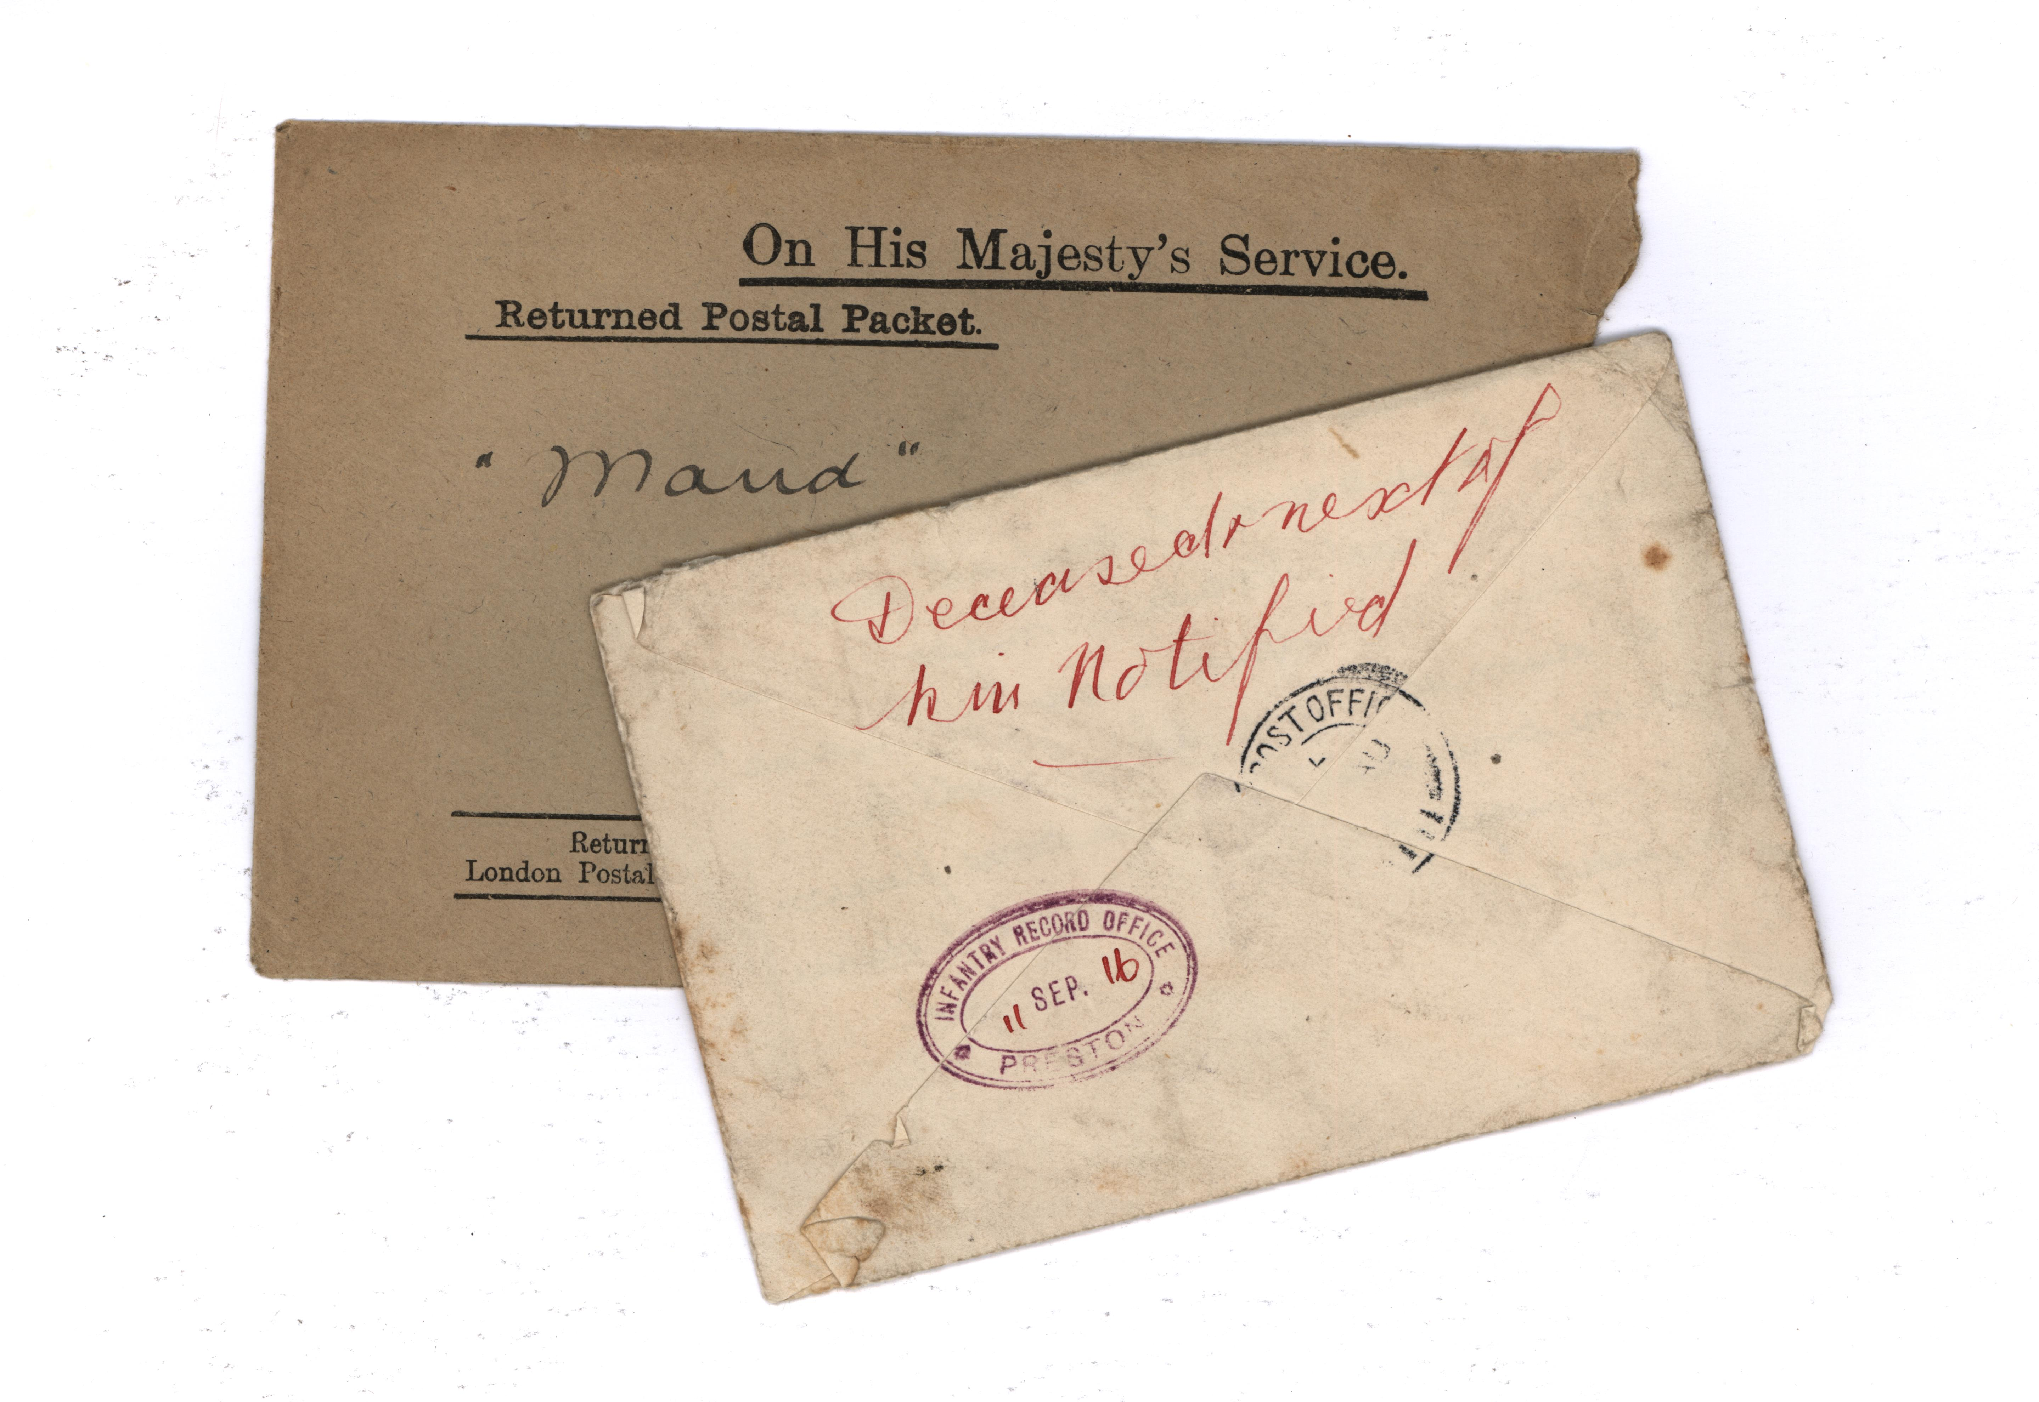

Slide 44
Telegram
The Telegram sent to Arthur Lloyd’s family containing a photograph of his sister Maud

Slide 45
Arthur Lloyd’s Grave

Slide 46
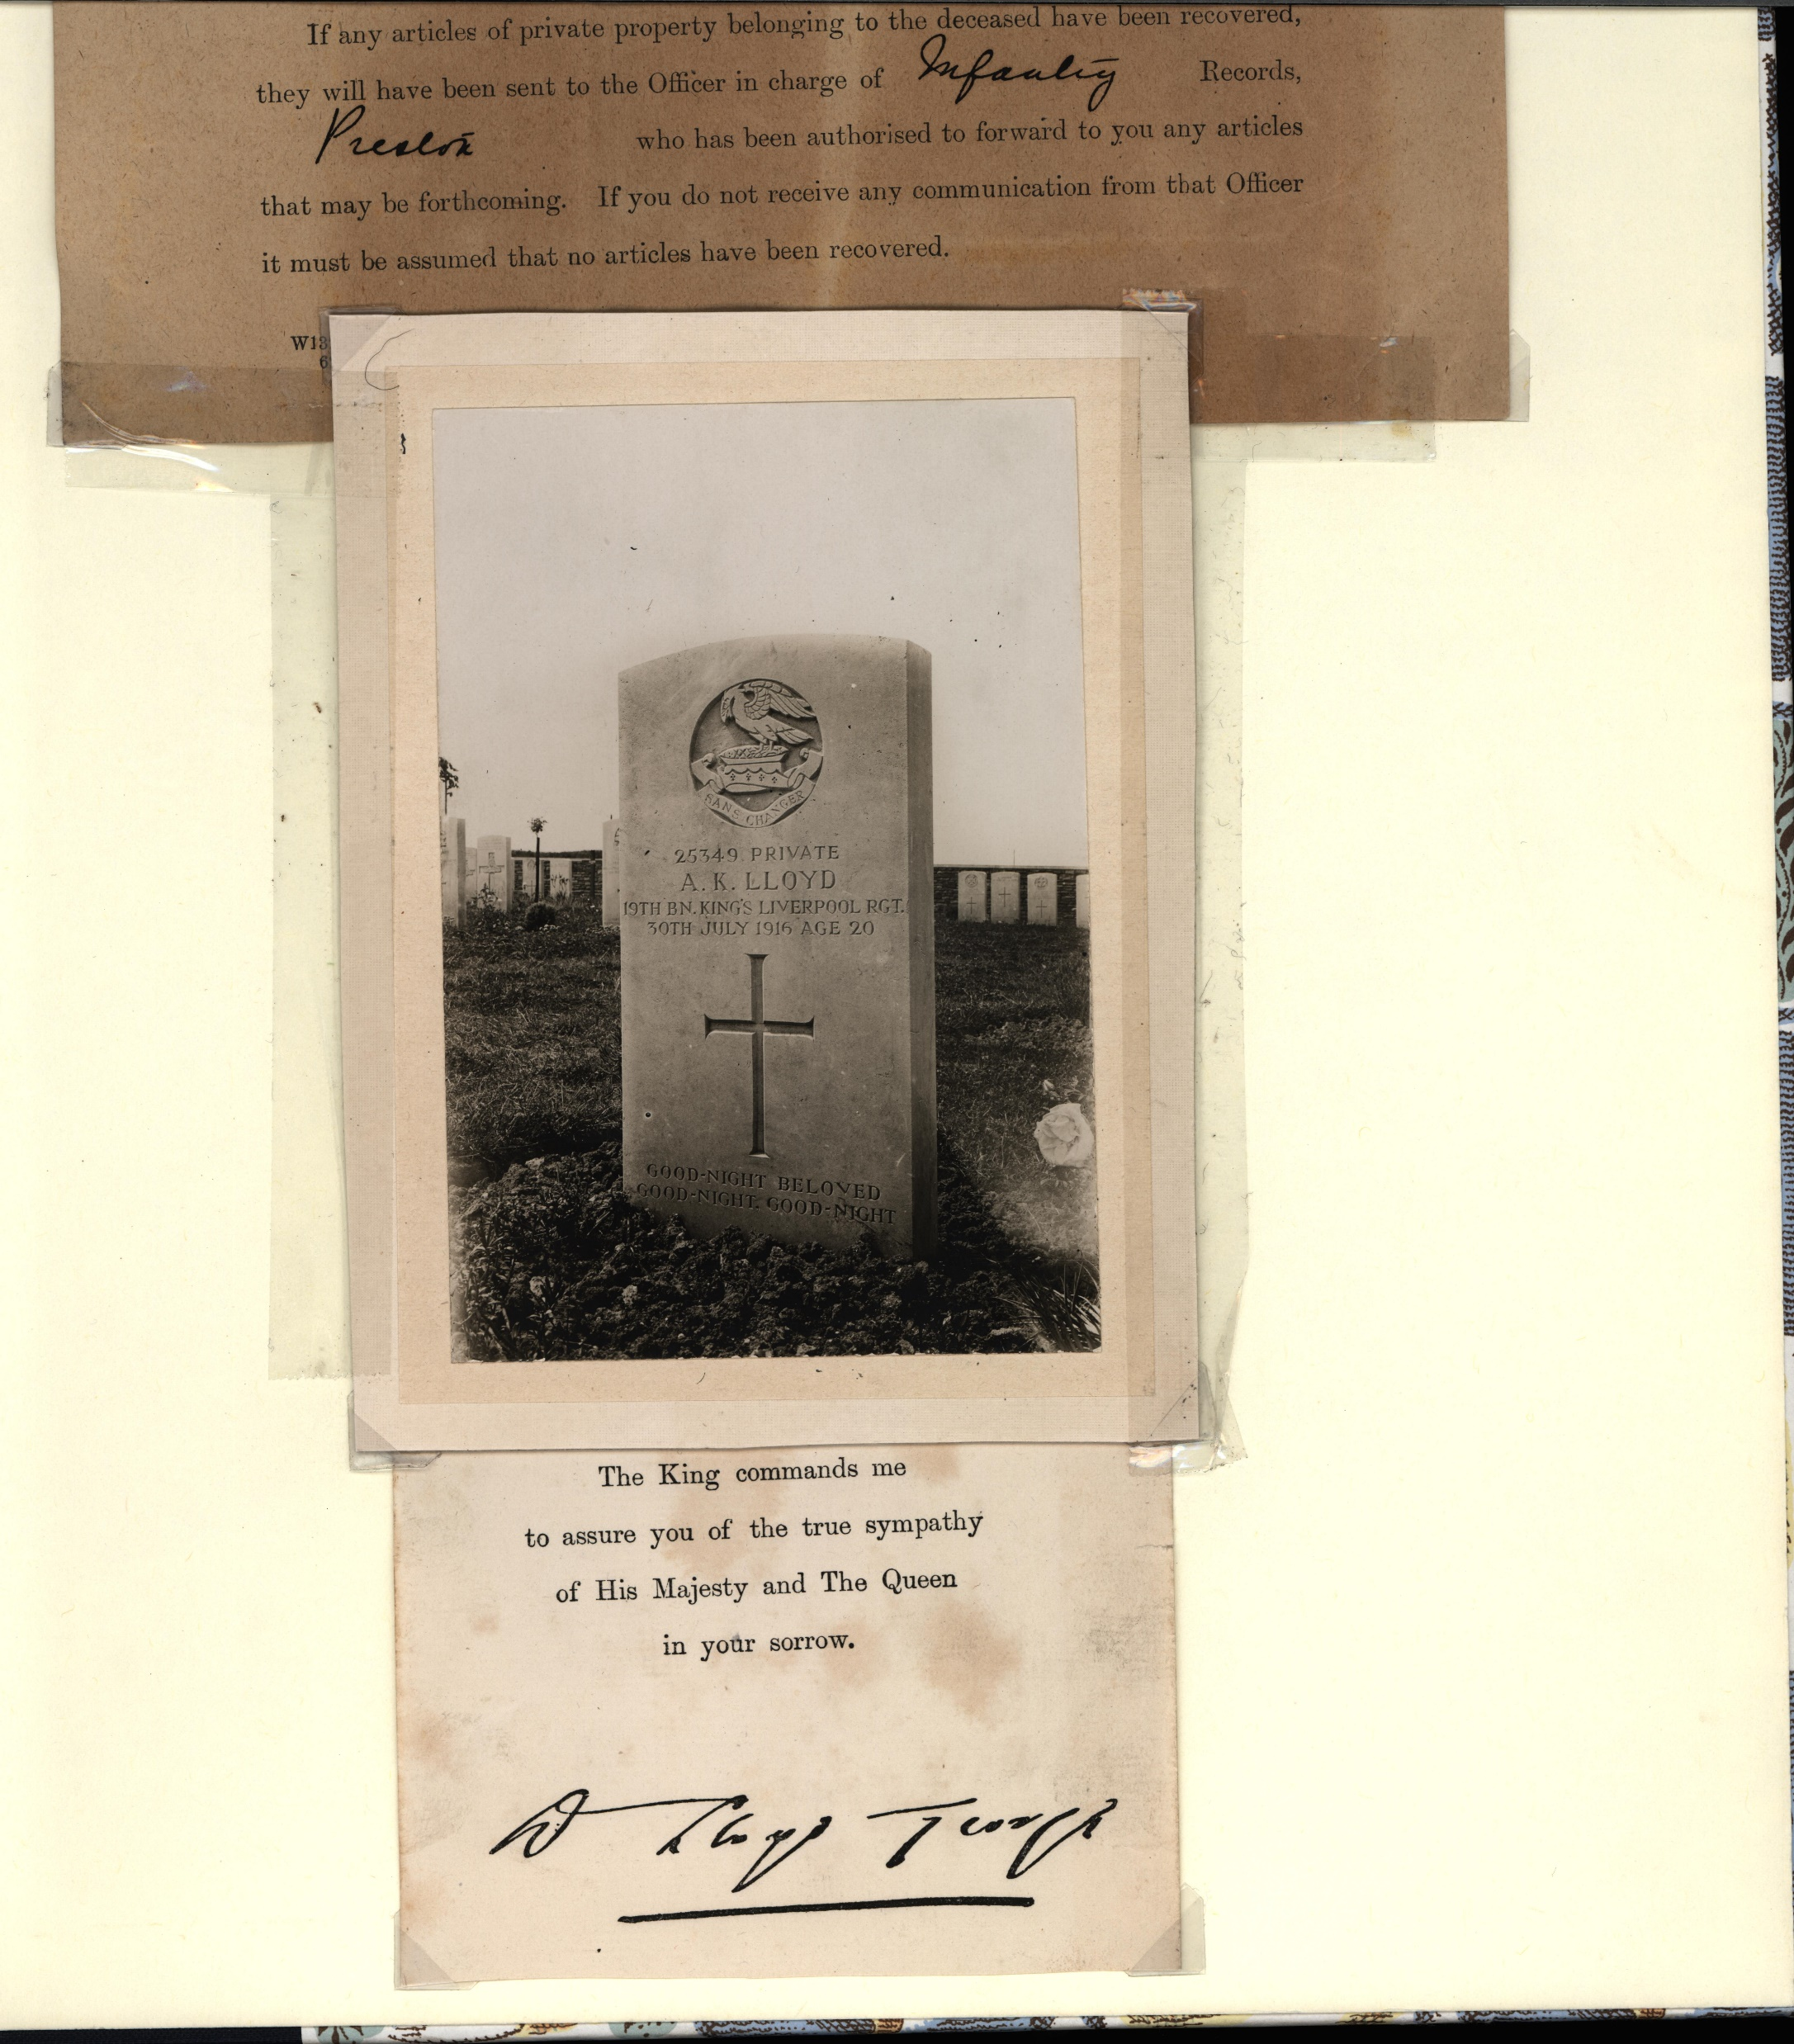

Slide 47
Contact John J. Campbell & Moira Kenny https://www.thesoundagents.com
http://soundagents.blogspot.com
Mobile: 07923925379

